Slide 1
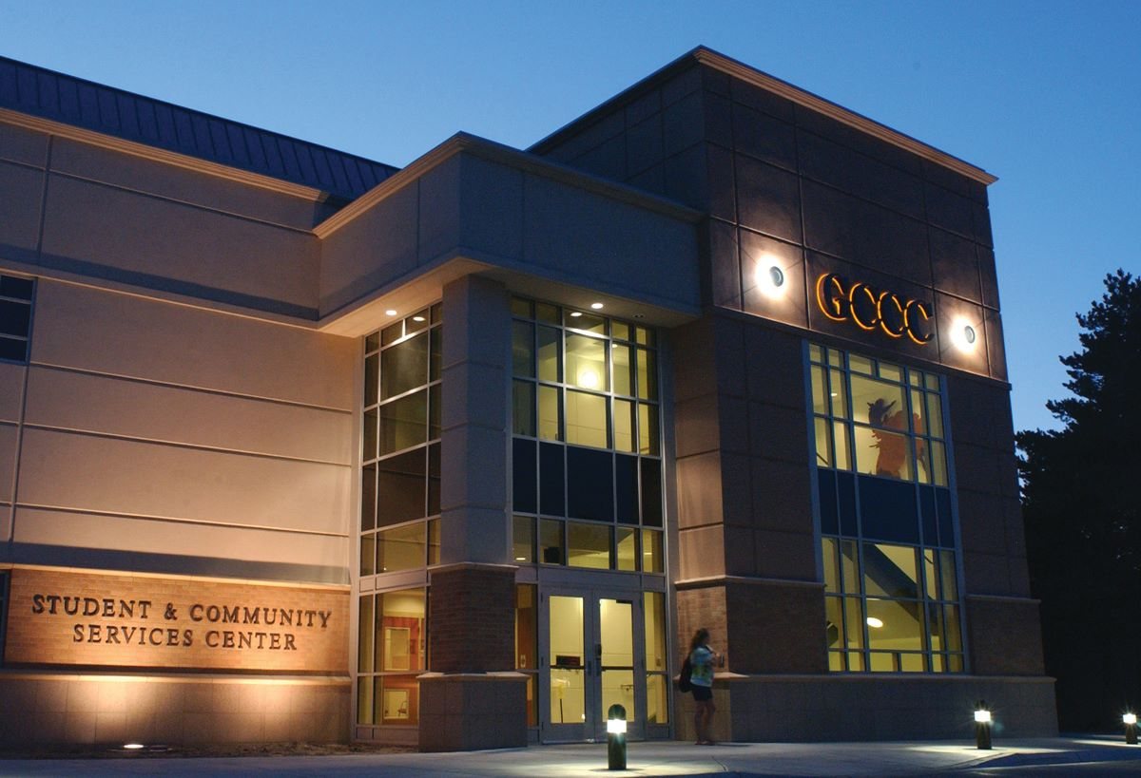
Garden City Community College

Slide 2
GCCC Master Facilities
2020

Slide 3
GCCC History
The Kansas Legislature passed the Community College Act in 1965, authorizing establishment of 22 independent colleges, including the Garden City Community College. This authorized the institution to levy taxes, conduct its own programs, and function independently of the K-12 school system. County voters elected the first College Board of Trustees in July 1965. Today, the College is one of 19 Kansas community colleges.
The present 63-acre main campus at 801 Campus Drive was designed between July 1965 and January 1966. On January 18, 1966, Finney County voters approved a $2.5 million bond issue, supplemented by a $538,000 federal grant, for construction, and ground was broken in September 1967. Also in 1967, revenue bonds were issued for construction of the original residence halls, Academic Building, Saffell Library, Administration Building, Fouse Science-Math Building, Pauline Joyce Fine Arts Building and Physical Education Building.
The Collins Technical Building was constructed in 1974, after a March vote in which a $300,000 bond issue passed by a 6-1 ratio. The total cost for the structure was $675,000.
A residential life addition, now known as the East Units, was built in 1978, with $875,000 in revenue bonds.

Slide 4
GCCC History
The college obtained approximately 75 acres in 1979 for $395,000. The land east of campus has been developed in a cooperative effort with the City of Garden City. The property includes softball and baseball fields as well as the College’s indoor baseball practice building and practice fields for football and soccer. The softball fields were named Tangeman Fields in honor of Dr. James Tangeman, former college president. In 2013, the college entered into a lease purchase agreement to fund a $2,600,000 turf football and soccer field with a running track and field events. The complex includes press boxes, bleachers and restroom facilities.
The Penka Building of Practical Arts and Sciences was added in 1986, when additions were completed to the Joyce, Collins and PE Buildings. The project was authorized by the College's Board of Trustees in December, 1984 at a total cost of $5,100,000 in certificates of participation, financed through a lease-purchase arrangement. Williams Stadium, a baseball facility was also added, with funds donated by Garry and Janet Williams of Kokomo, Indiana.
In January of 1996, a 15,000 square foot, $1.4 million dollar technical teaching laboratory was completed so that the College could provide more training for workers in area and national industries, including Industrial Ammonia Refrigeration and Industrial Production Technology. A three-building student apartment complex opened in 2002.

Slide 5
GCCC History
In 2003, construction began on a 12,900-square Student Center addition, which opened in January 2004. Attached to the original student center structure, the facility was named the Beth Tedrow Student Center. The structure contained the campus bookstore, a portico-style meeting area, a walk-through student art display area, the campus health center, offices for the student government and the student activities director, space for informal gatherings and a student theater.
In addition to the construction of the Beth Tedrow Student Center, three Residential Life Apartments were built increasing on-campus housing capacity from 234 to 306. The housing addition opened in the fall of 2002.
In July of 2005, ground was broken on a 19,260 square foot “Front Door” project. The addition is located just south of the original Administration Building. The three-level, two-story structure was designed as a student and community service center consolidating public and student services streamlining the enrollment process, adding modern classrooms, housing adult education and providing a single location for most assistance provided by the College. Completion of the project occurred in 2006.
In coordination with the City of Garden City, a fire science classroom and live burn training tower was completed on the college campus in 2008. The Live Burn facility is the only such facility in Western Kansas.

Slide 6
GCCC History
In 2009, with funds obtained through a Title V grant, the Erdene Corley Simulation Lab was completed adding 7,000 sq. ft. to the Penka building and providing state-of-the-art technology including nine simulators for the nursing and allied health programs. The grant also provided funds to remodel three science laboratories in the Warren Fouse Science and Math Building. Over the next few years, the college funded the complete renovation of the Fouse Building, including ADA restrooms.
Mill rate increased to provide funds for deferred maintenance items such as parking lots, fire alarms, etc.
Renovations to the Academic Building occurred during 2011 and 2012. Renovations mirrored those which occurred in the Fouse Building, new lecture hall seating, new lighting, carpet installation, airlock exterior entrances and the addition of ADA restrooms.
The College received funding through a U.S. Department of Labor grant – Trade Adjustment Assistance Community College and Career Training (TAACCT). The grant provided the animal science program a state of the art meats lab and mobile training classroom.
In 2011, the College acquired a 3,280 sq. ft. building located at 724 Campus Drive became the Access and Opportunity Center. The building housed offices and classrooms for the Migrant Family Literacy and refugee service programs for the GCCC Adult Learning Center.
The college was able to purchase six acres and an in-door arena from Finney County Commissioners. The land and building are currently being utilized by the GCCC Rodeo Team.

Slide 7
GCCC History
In 2013, the college purchased a 14,487 square foot pre-engineered steel building on approximately 1.3 acres directly south of the main campus. A portion of the building was converted into a welding lab, classroom and instructor offices. Partial funding for the remodel was provided through the Kansas Technical Retraining Among Industry-targeted Networks (KanTRAIN) grant project awarded by the U. S. Department of Labor’s Trade Adjustment Assistance Community College and Career Training program. The Kansas Army National Guard Training Center is located in the front of the building. The center consists of numerous offices and a classroom. Later that year, the college purchased an additional 2.1 acres adjacent to that property. Eight student housing units were constructed as well as a manager apartment and laundry facility/tornado shelter. The housing complex opened January 2015.
During 2015, the college purchased a 4,800 square foot building directly south of the athletic complex. In 2017, the building was remodeled to accommodate the instrumental music program and GCCC marching band. A few months later, the college was able to purchase 2.5 acres adjacent to this property.
In 2016, the college purchased four apartment buildings south of campus on Laurel Street. The property named Broncbuster Suites provided housing for an additional 80 students. In 2017, the college purchased the remaining apartment buildings at the Laurel Street location; bring the total number of beds at that location to 165.

Slide 8
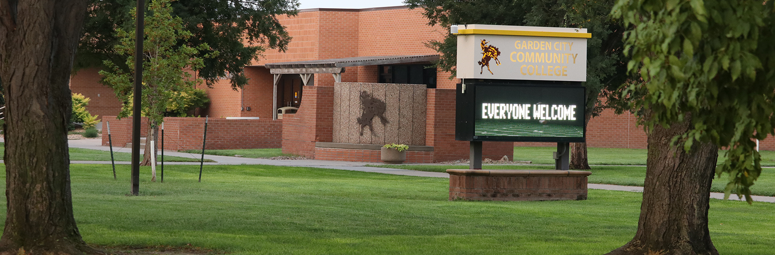
Garden City Community College Facilities
2021

Slide 9
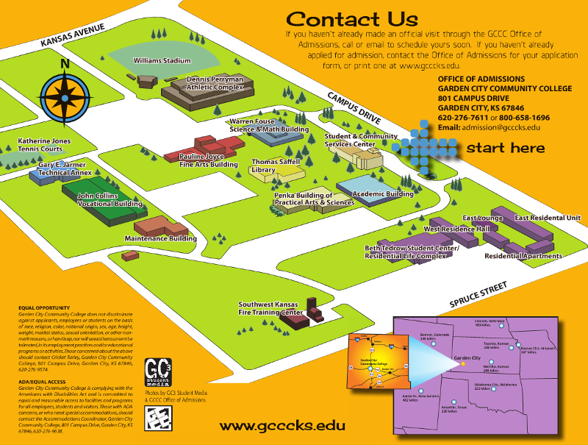
GCCC Campus Map

Slide 10
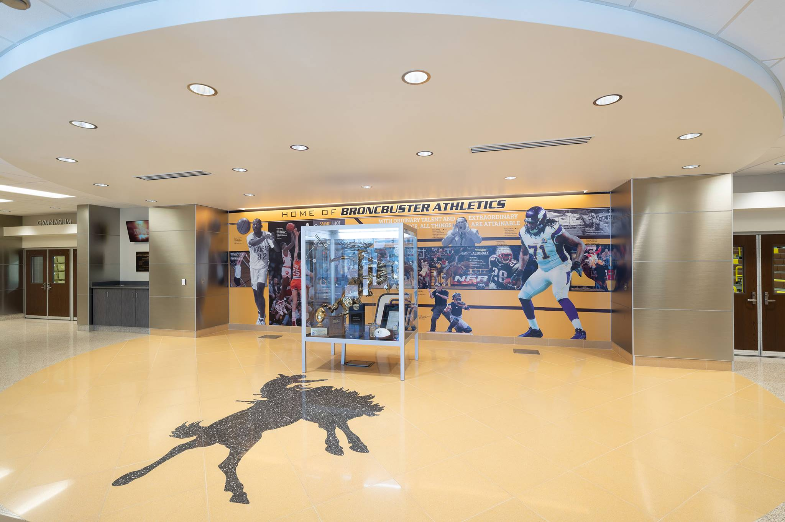
Dennis Perryman Athletic Complex
D.P.A.C.
Constructed 1970 – 44,693 sq. ft.
1985 – Addition to building
1979 – Tennis courts constructed $44,632
2006 – Masonry restoration
2007 – Women’s locker room renovation
2009 – New fire alarm system installed - 4010 ES ng lot lighting improvements
2016 – Renovation of lobby
2012 - New fire alarm system installed - 4010 ES
2016 – Parking lot complete renovation
2017 – Main gym remodel – flooring, bleachers, volleyball nets
2021 – DPAC Roof replacement complete outside of upper north

Slide 11
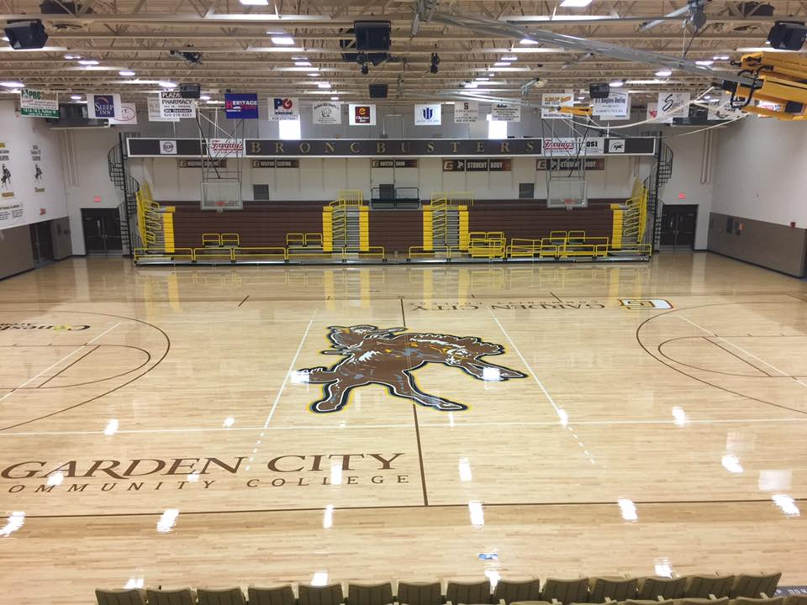

Slide 12
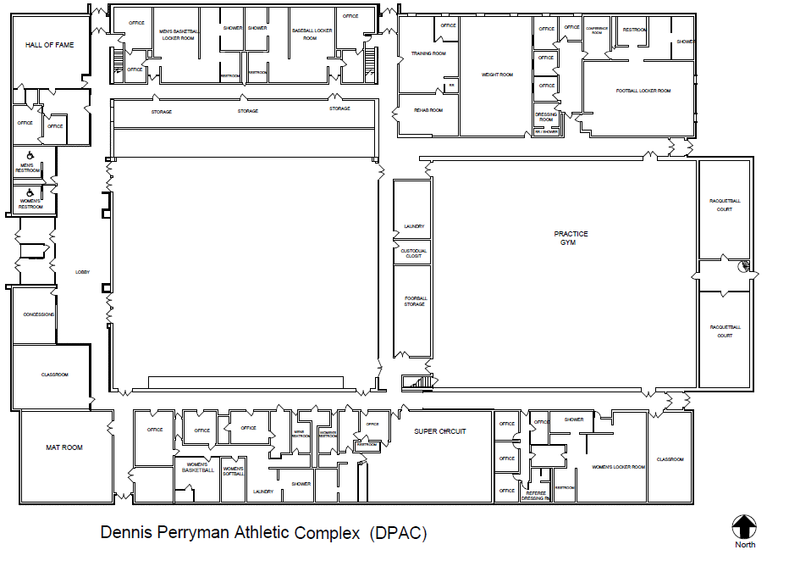

Slide 13
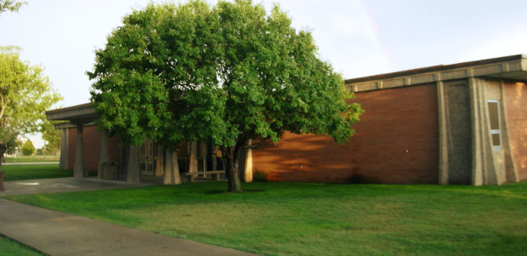
Academic Building
ACAD
Constructed in 1969 – 23,403 sq. ft.
1986 – South end of building remodeled to include Financial Aid Offices – cosmetology moved to Penka Building.
2007 – Renovation of faculty offices
2009- -Finnup Lab remodel
2010 - Lecture hall remodel
2011- West Side renovation
2012 – East side renovation
2013 – New fire alarm system installed - 4010 ES

Slide 14
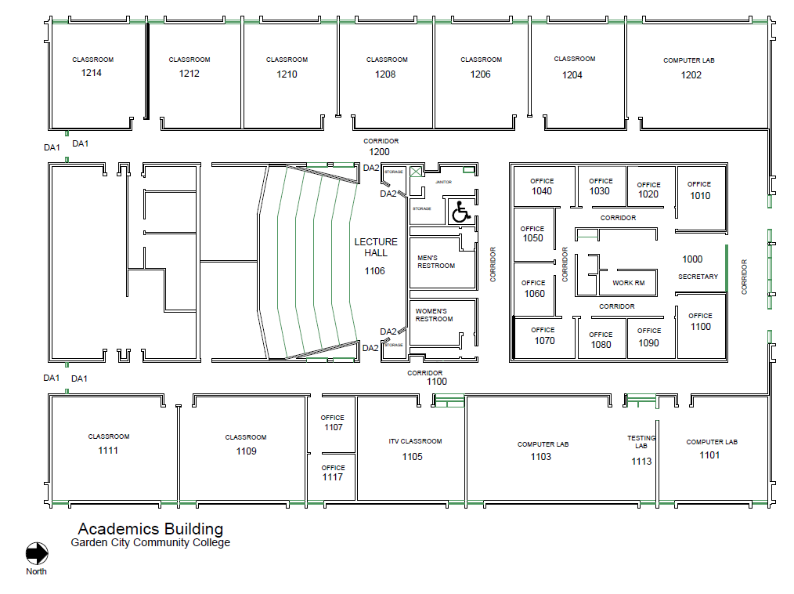

Slide 15
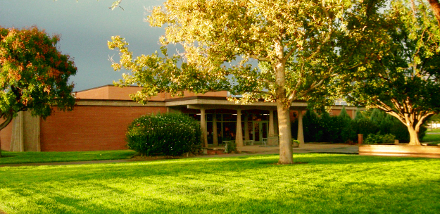
Science & Math Building
FOUS
Constructed in 1969 – 24,250 sq. ft.
Fourteen instructional areas
  Seven labs (including police science lab)
  Six general classrooms
  One lecture hall – capacity 134
2009 –2010 - Renovated 3 science labs, lecture hall, ADA restrooms, classrooms, greenhouse and installation of airlock entrances
2010 - New fire alarm system installed – 4010ES

Slide 16
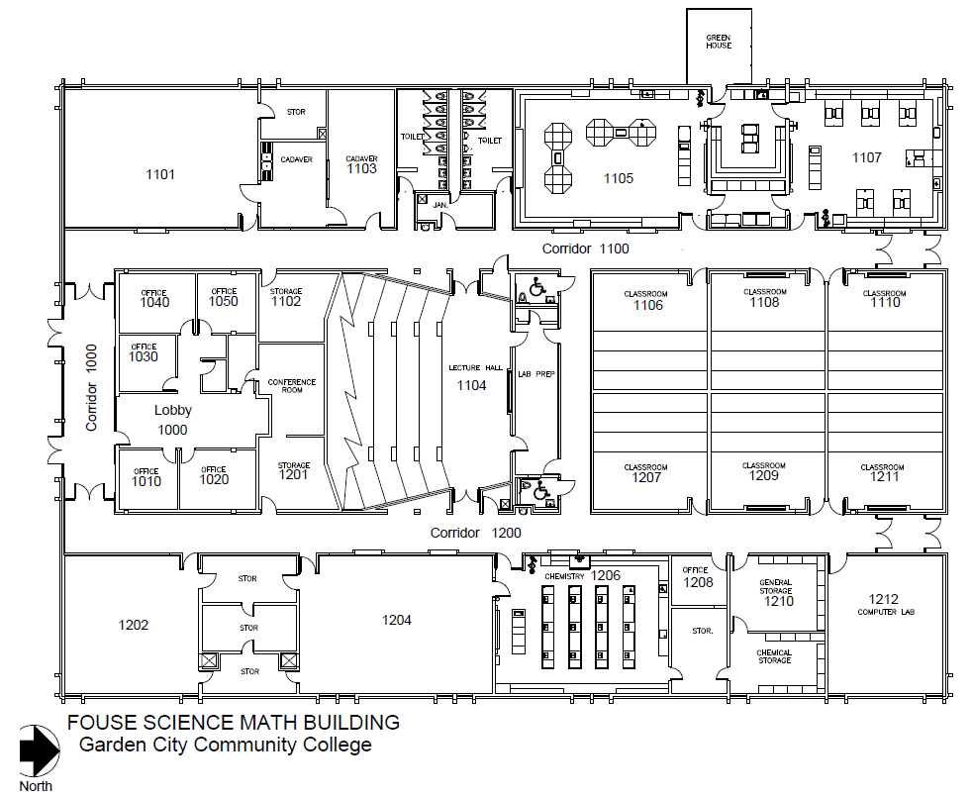

Slide 17
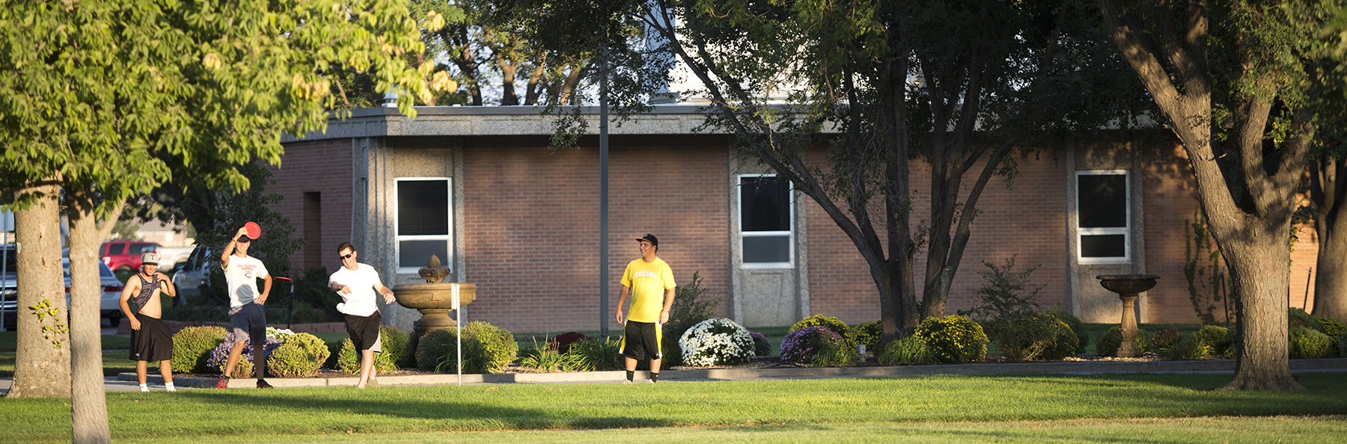
GCCC MAIN CAMPUS QUAD
2018

Slide 18
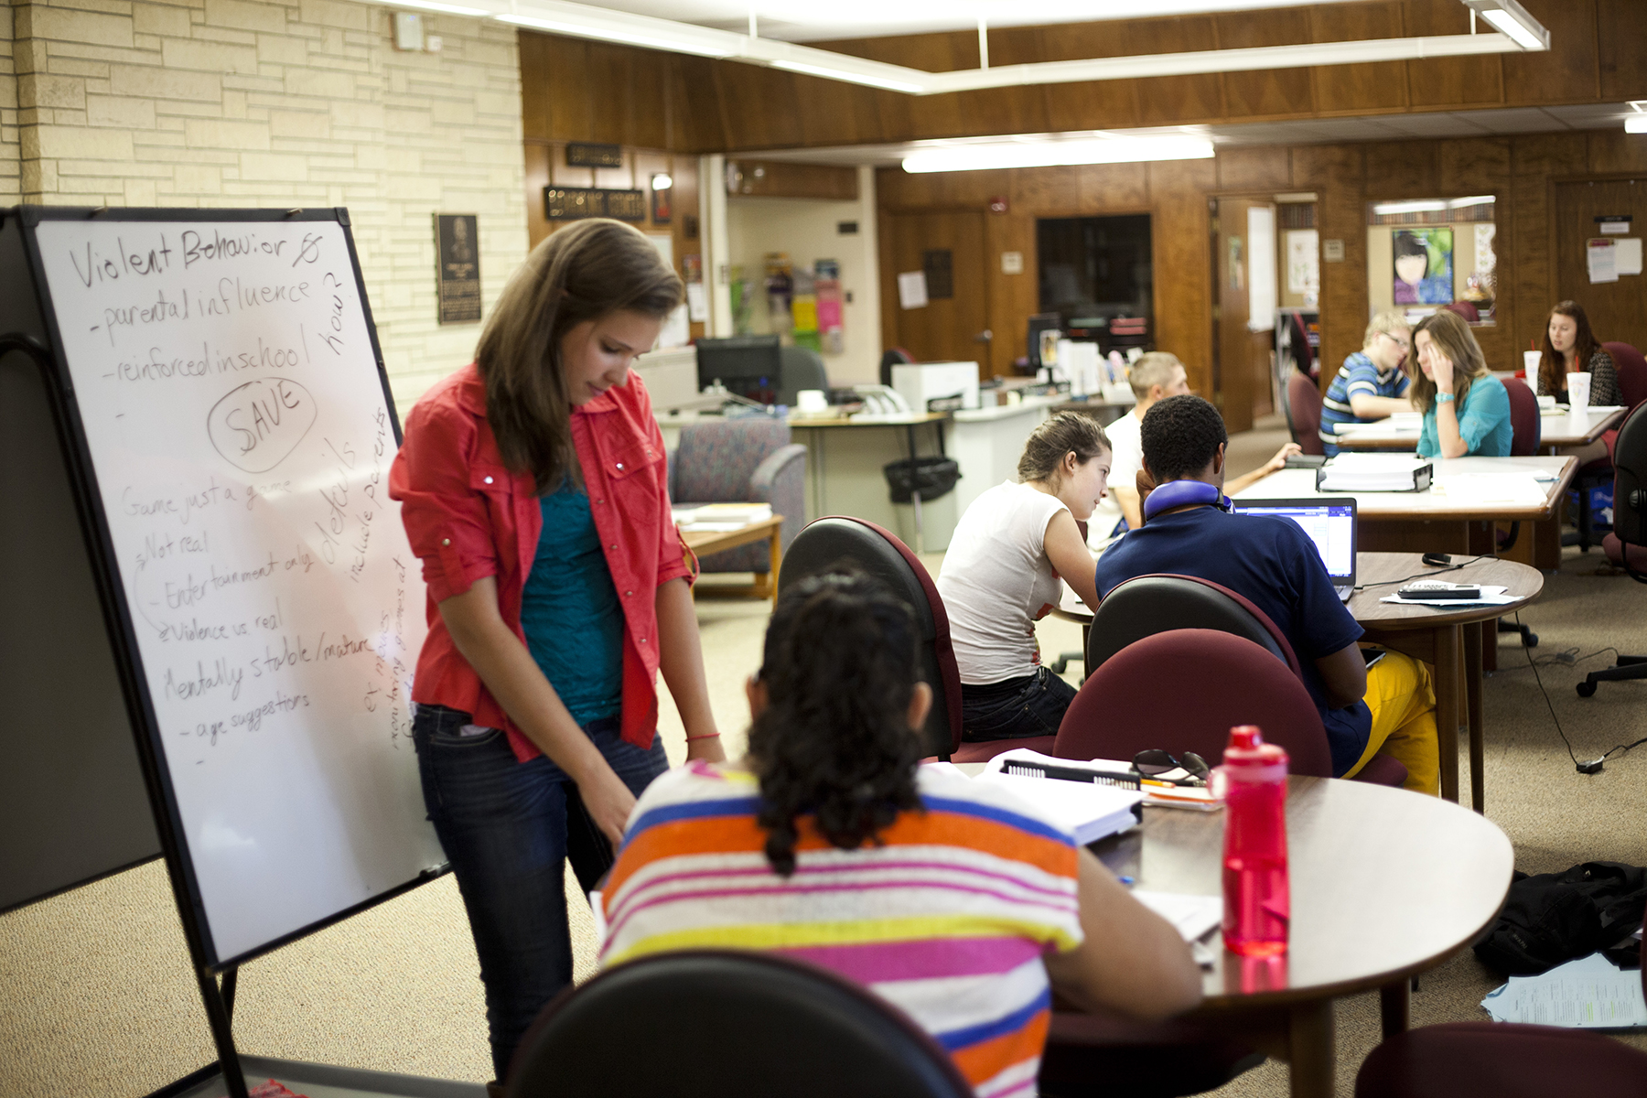
GCCC Library
SAFL LIBRARY
Constructed in 1969 – 19,416 sq. ft.
Designed to be enlarged by an addition to the west. Also, provisions were built into the building to allow the construction of a loft area in the west portion of the reading room
In its original design, the library contained several offices and storage areas.
1980 - Two areas were remodeled to accommodate ROTC. The library also houses the GC Historical Society, teacher offices, the computer terminal, public relations, two study skills areas, two conference rooms and the career center
1988 – Offices added to the main lobby
1990 – Converted restrooms to handicap accessible
2002 – Renovation to replace carpet and install in-floor utility duct
2004 – Electrical upgrades, painting & carpet
2017 – Roof Replacement
2021 – FHSU Transfer Center Remodel

Slide 19
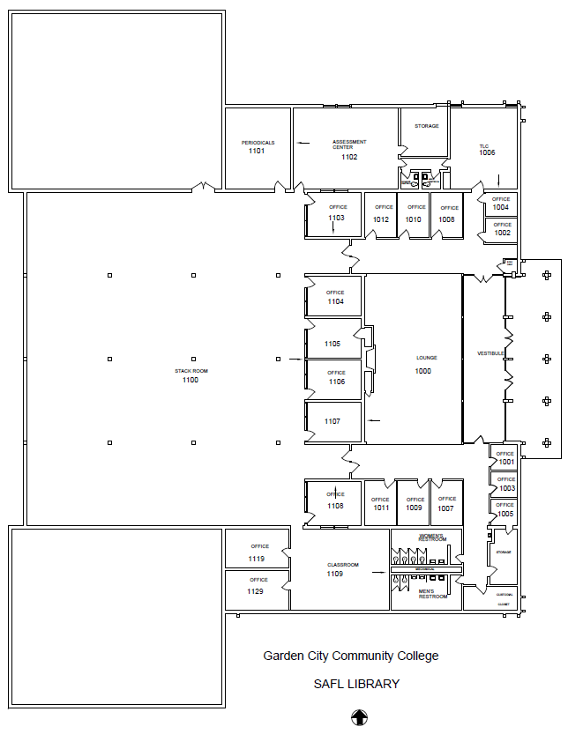

Slide 20
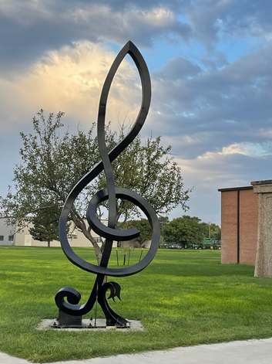
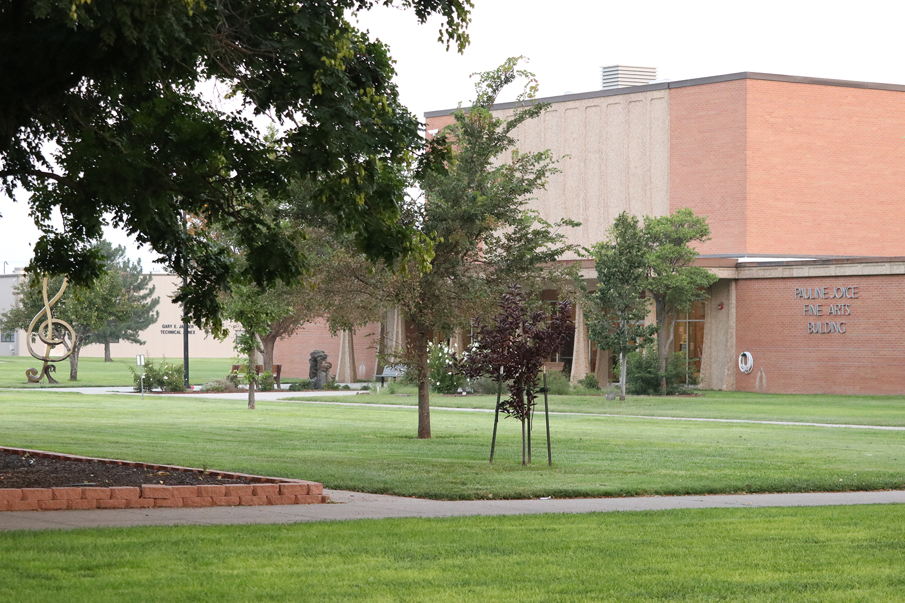
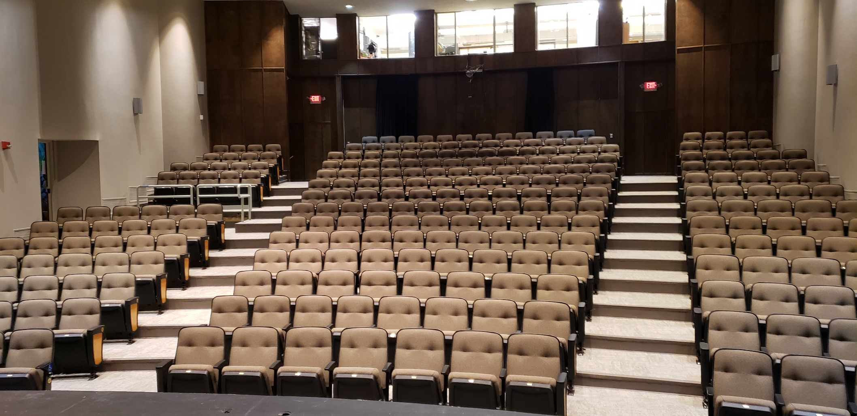
Joyce Fine Arts
Constructed in 1969 – 27,522 sq. ft. (including basement & 2nd floor)
308 theater capacity
9 instructional areas (including auditorium)
1985 - Added west wing and north east classrooms
2003 – Renovation of roofing and roof vents
2004 – Auditorium renovation – flooring, paint, reupholster seating, wall fixtures, strip and refinish stage, sound soak, replace tile in lobby
2009 – Gas kiln installed – kiln room remodel
2011 – Remodel faculty office area
2012 – New fire alarm system installed - 4010 ES
2021– Repainted the auditorium walls and trim
  Replaced seating in auditorium
  Installed carpet
  Repainted the Cleft art installation

Slide 21
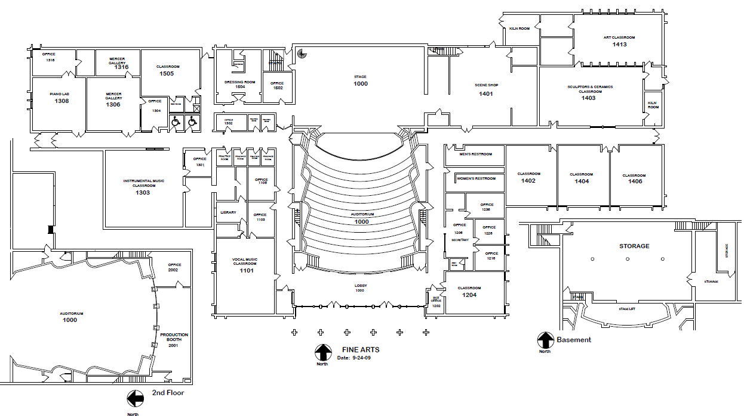

Slide 22
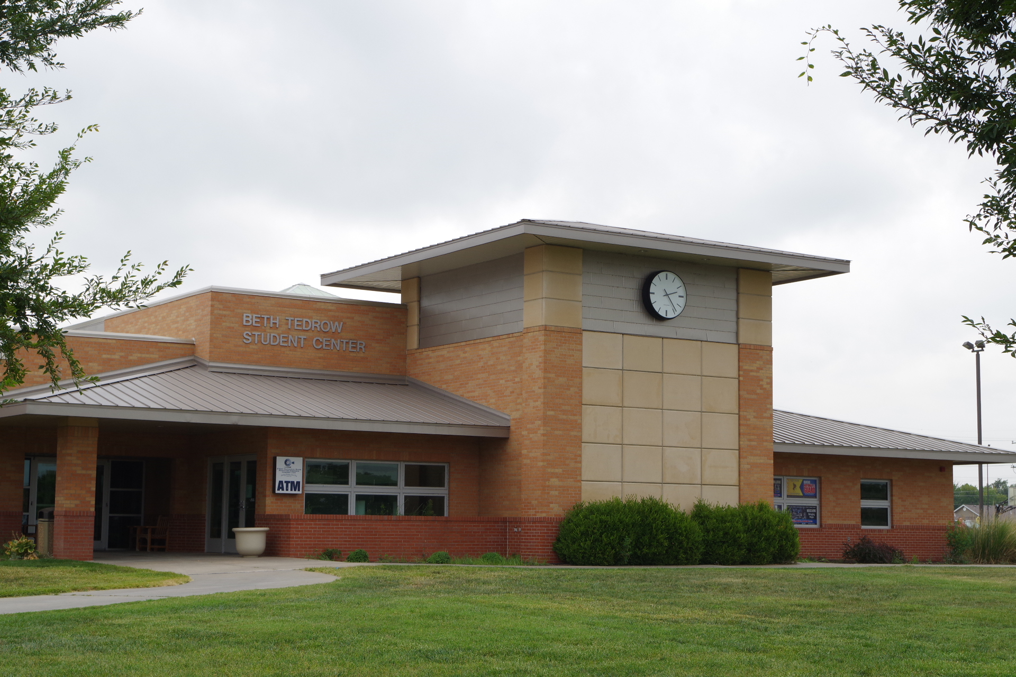
Beth Tedrow Student Center
BTSC
Constructed 1969 – 17,986 sq. ft.
Student center houses cafeteria, kitchen, student lounge, game room, snack bar, bookstore and several offices
Dining room ix 84 Ft X 53 ft. = with seating capacity of 300 people
1990 – Remodel – removed walls, relocated game room, moved computer room, resurfaced parking lot
2003 – Addition to the Student Center
2004 – Outdoor recreational facilities installed
2006 – Added court lighting
2011 – Kitchen renovation – replaced drains and electrical, installed new dishwasher
2015 - Remodeled lobby and moved bookstore to main floor – Revenue Bonds

Slide 23
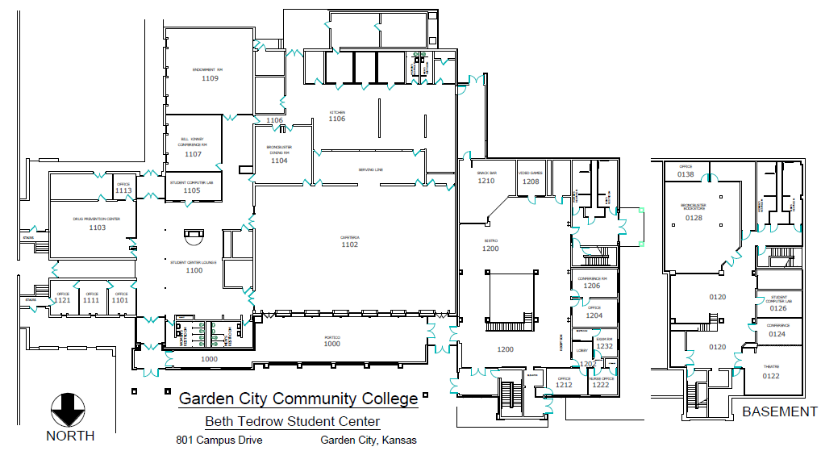

Slide 24
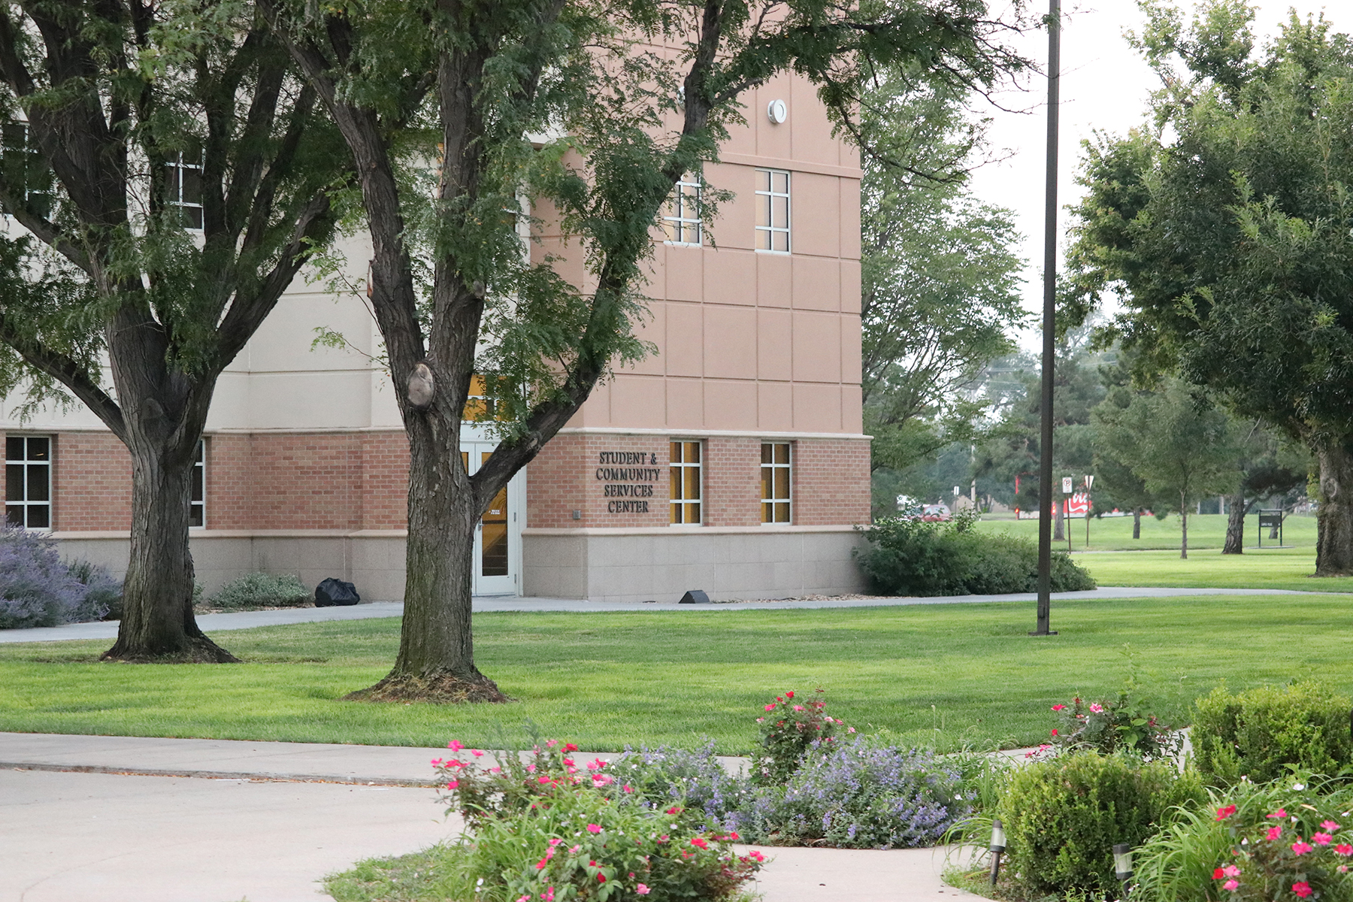
Student & Community Service Center/Administration
SCSC & ADMIN
Constructed in 1969 – 6,927 sq. ft.
2004 – east parking lot to concrete
2005 – remodel business office
2012 – relocated President’s Office – endowment association
Student Community Service Center (Front Door)
2006 addition to Administration Building – upper floor serves continuing education, main floor student services and basement serves GED and adult education

Slide 25
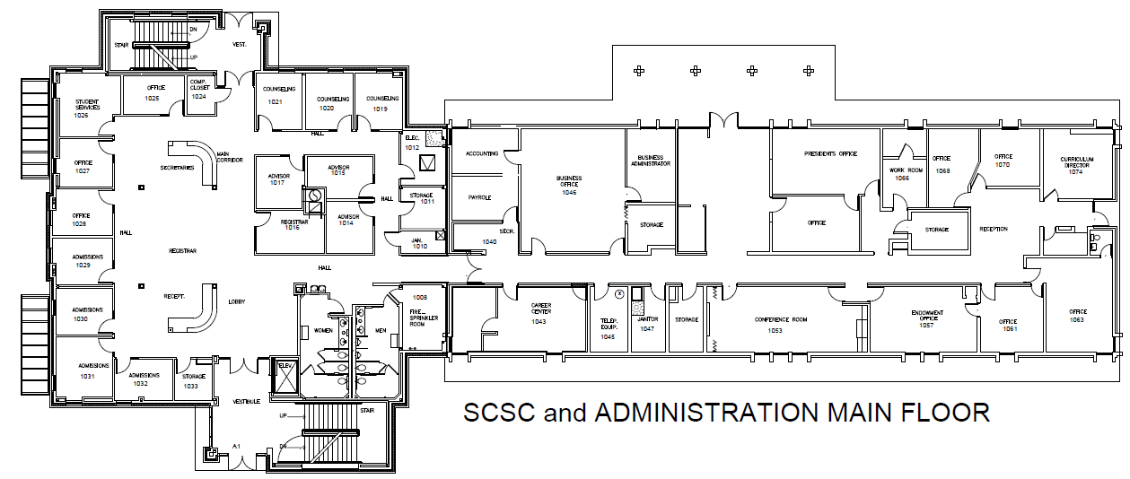

Slide 26
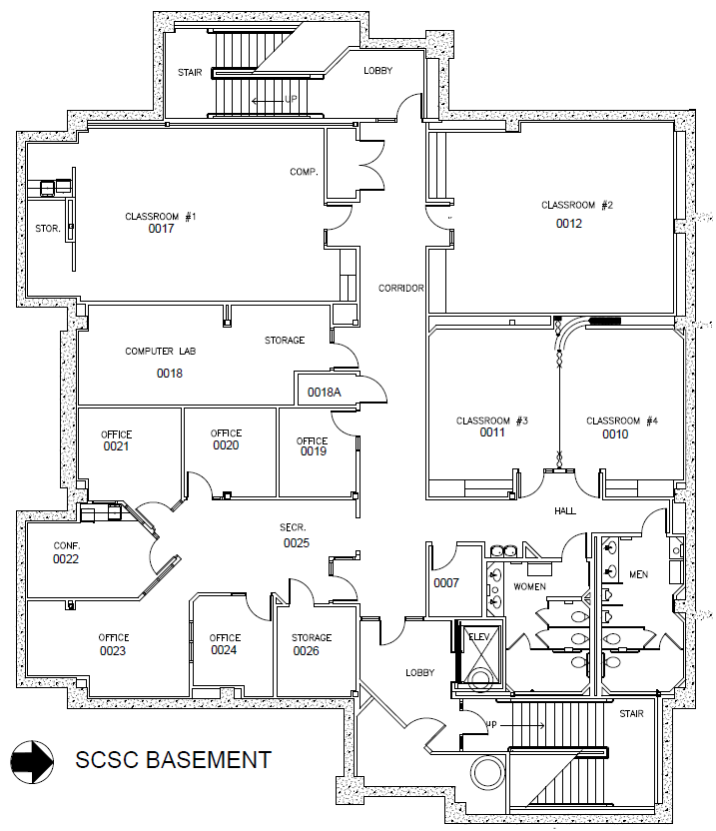

Slide 27
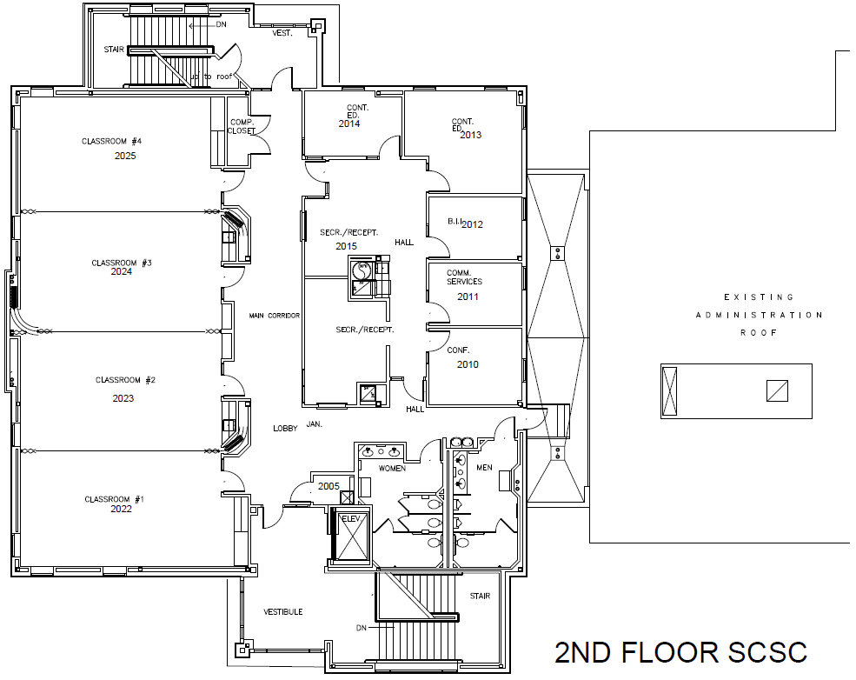

Slide 28
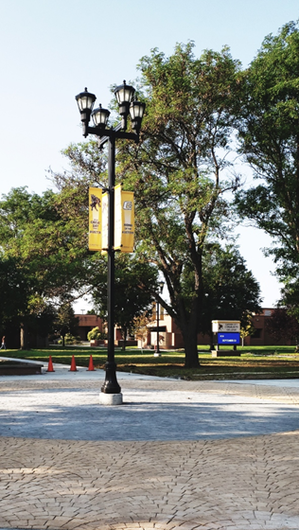
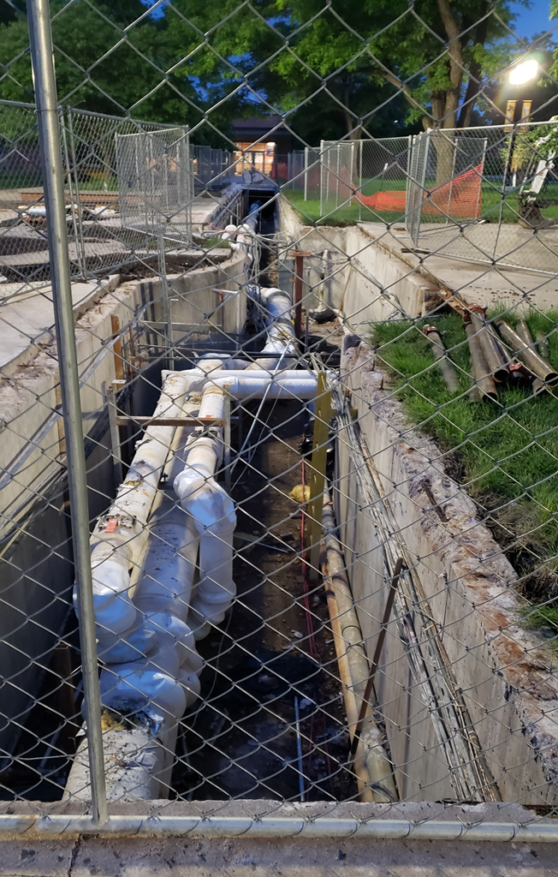
Quad Tunnel Cap &
Hydronic Pipe Replacement
2017 – Phase 1 of the Tunnel cap replacement
  Removed and replaced pedestrian sidewalks in the campus Quad that also serve as the utility tunnel cap
  Replaced 750 feet of the hot side Hydronic piping.
2019 – Phase 2 of the Tunnel cap replacement
  Removed and replaced pedestrian sidewalks in the campus Quad that also serve as the utility tunnel cap.
  Replaced 1,014 feet of the hot side Hydronic piping
2021 – Phase 3 of the Tunnel cap replacement
  Removed and replaced pedestrian sidewalks in the campus Quad that also serve as the utility tunnel cap
  Installed drainage wells and decorative concrete Replaced 1,225 feet of the Hot side Hydronic piping under the Quad
  Installed valves and expansion couplings
  Insulated all piping to reduce heat loss

Slide 29
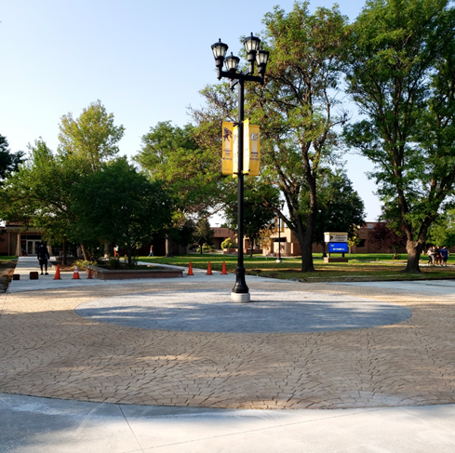
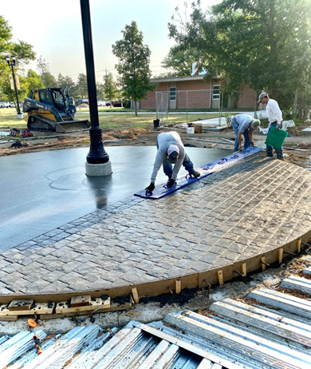
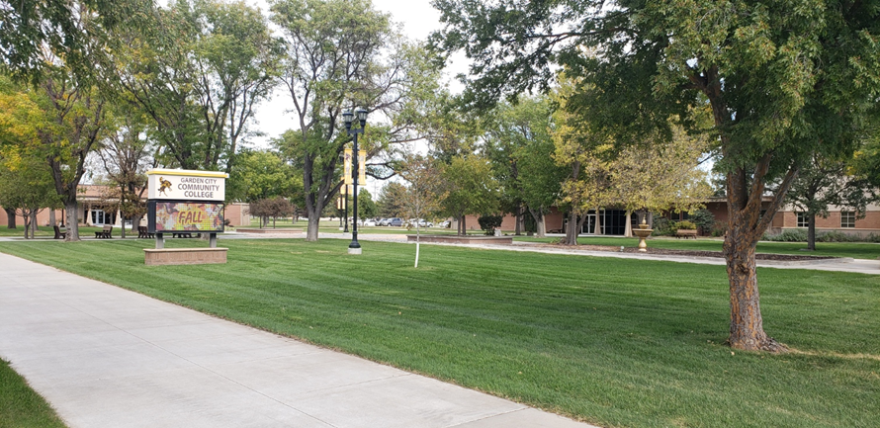
Campus Quad Landscaping
2021
Installed decorative stamped concrete
Replaced sidewalks
Installed new irrigation system
Installed sod in Quad and surrounding areas
Installed drainage system to reduce flooding

Slide 30
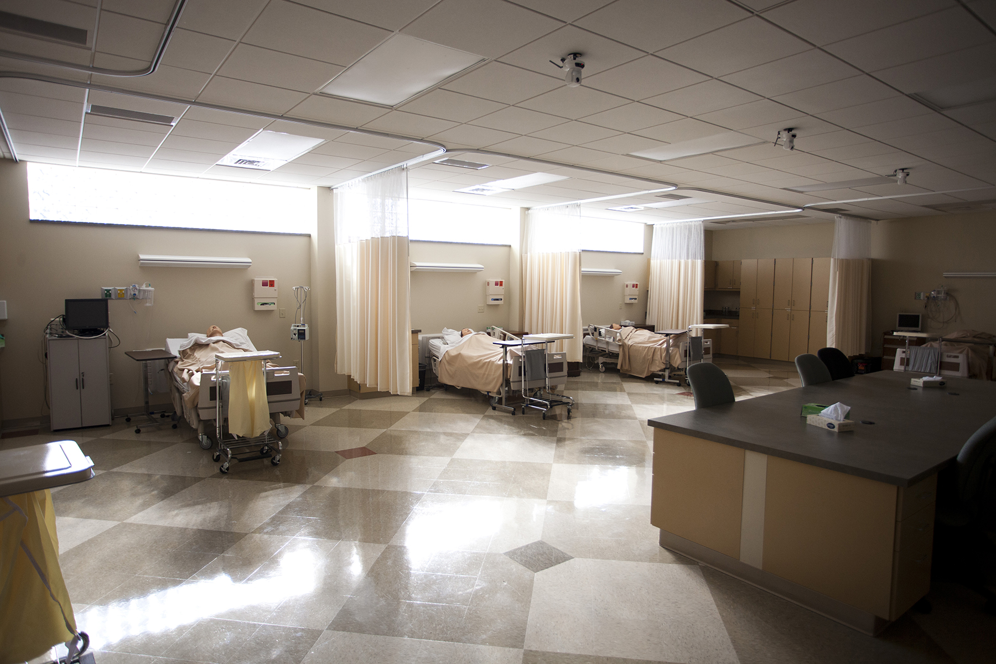
GCCC Penka Building
Penka
Constructed 1985 – 15,228 sq. ft.
Nursing, home economics and cosmetology, daycare center and student snack bar
2004 – Penka parking lot to concrete
2004 – Convert classroom to computer lab
2008 – Erdene Corley addition – simulation lab
2009 – Installed new fire alarm system New 4100ES

Slide 31
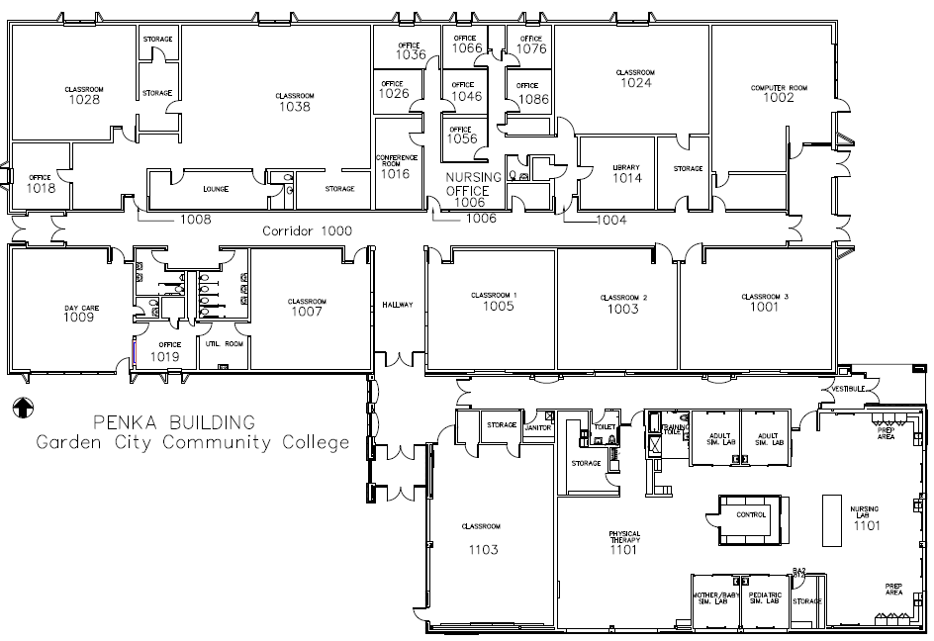

Slide 32
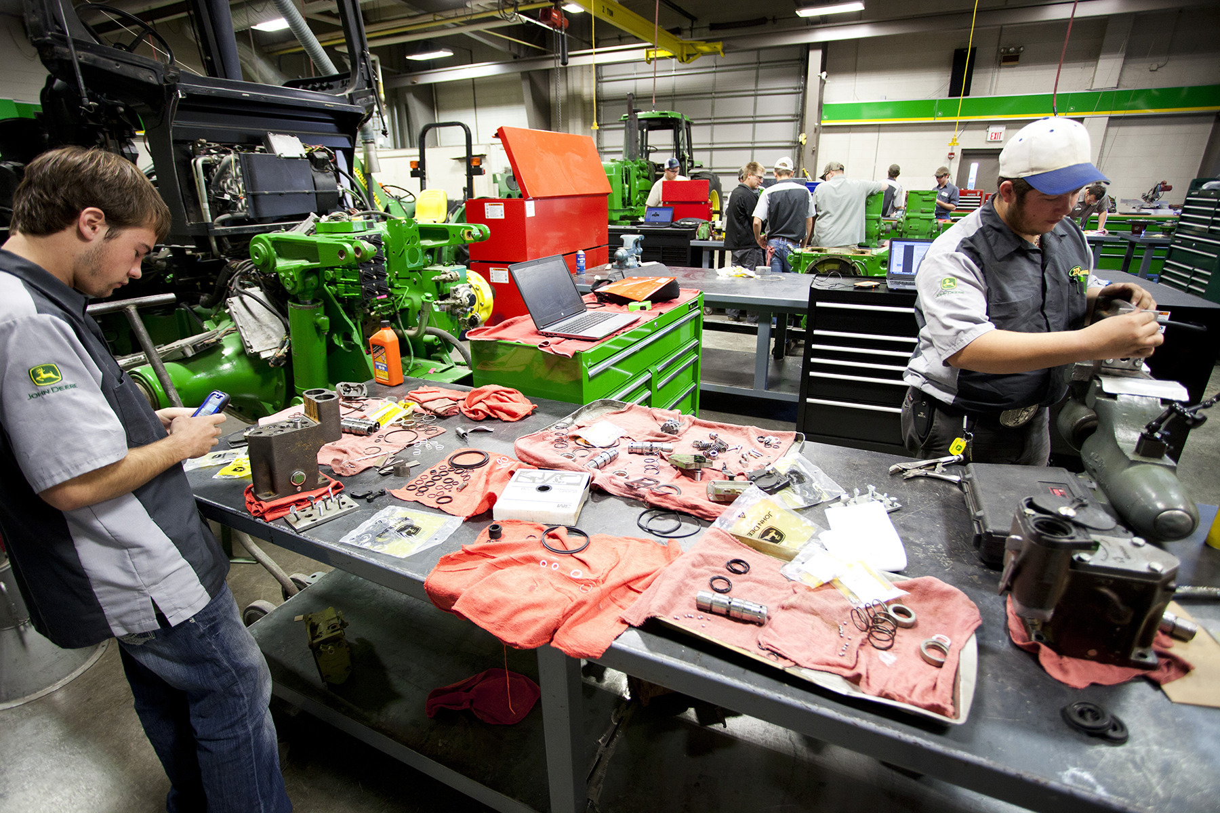
John Collins Vocational Building
JCVT
Constructed 1974 – 33,628 sq. ft.
  18 instructional areas
  10 classrooms
  6 shop areas on main floor
  2 shop areas on the mezzanine
Mezzanine areas used for masonry, plumbing, and small motor repair labs
1979 – welding shop limited to 10 stations
Auto and ag shared space
Nursing space used to the maximum – sharing classroom with general instruction
1982 - Two additions to John Collins Vocational Building – 46,974 sq ft space for graphic arts, building trades, auto mechanics and agriculture.
2008 - remodeled old masonry lab to accommodate welding program
2009 - New fire alarm system installed - 4010 ES
2010 – Remodeled publications lab
2013 – Expanded animal science/meats lab
2018 – Replaced JCVT entire gravel and metal roofing
2019 – Remodeled to move John Deere to Annex and expand Automotive into old John Deere shop.

Slide 33
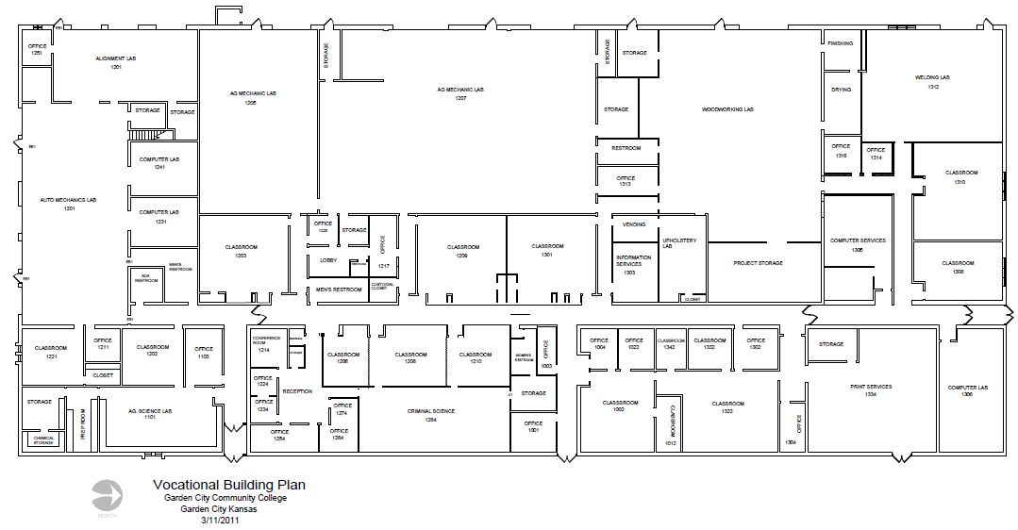

Slide 34
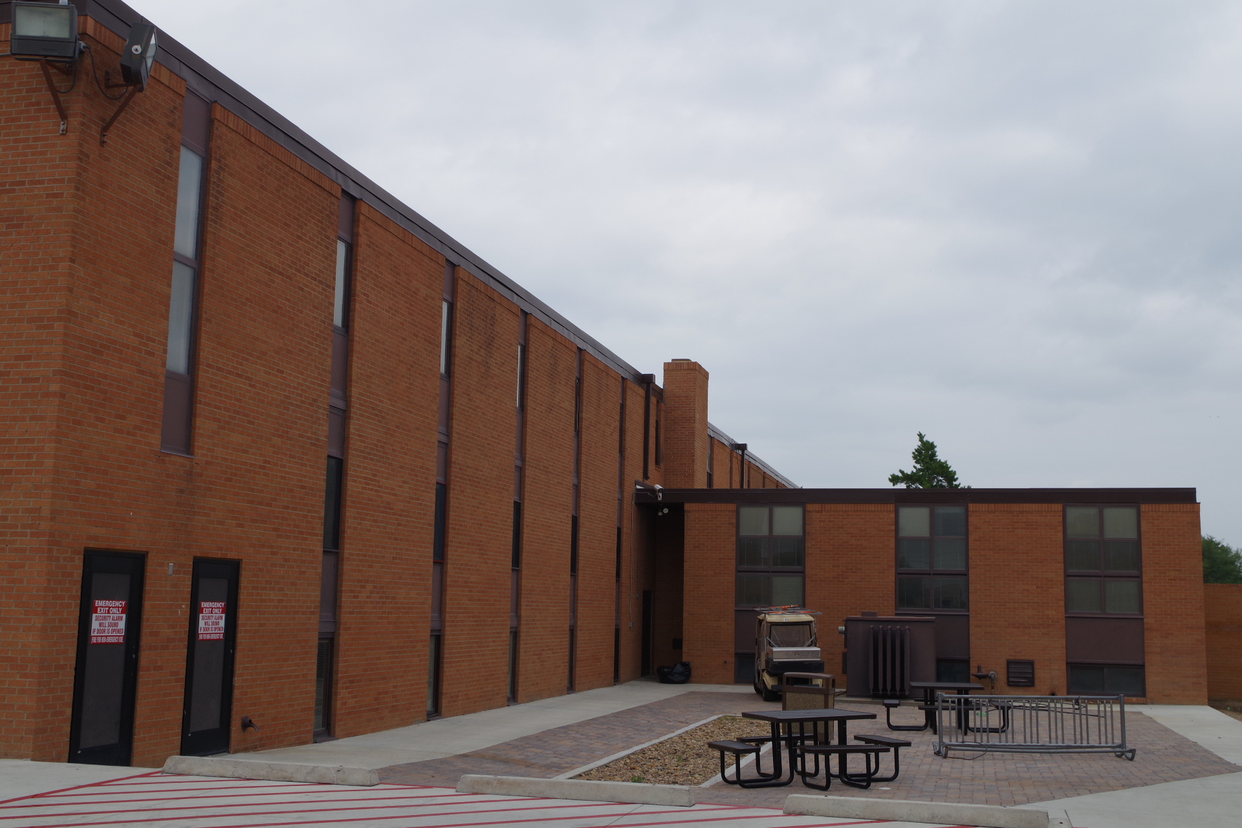
GCCC West Dormitories
West Hall
Constructed 1967 – 27,018 sq. ft.
Capacity is 124
Three floors – study areas on each floor
Director’s apartment – two bedroom apartment, with offices and visitors lounge
Laundry facilities, storage, lounge and study areas.
Rooms are 12 X 18 – 216 square feet
2002 - Remodel dorm bathrooms & install kitchenettes in TV Rooms
2010 – New fire alarm installed
2021 New Domestic water heaters and holding tanks installed
2021 Installed 2 Dedicated Outdoor Air Systems (DOAS) units to improve ventilation issues

Slide 35
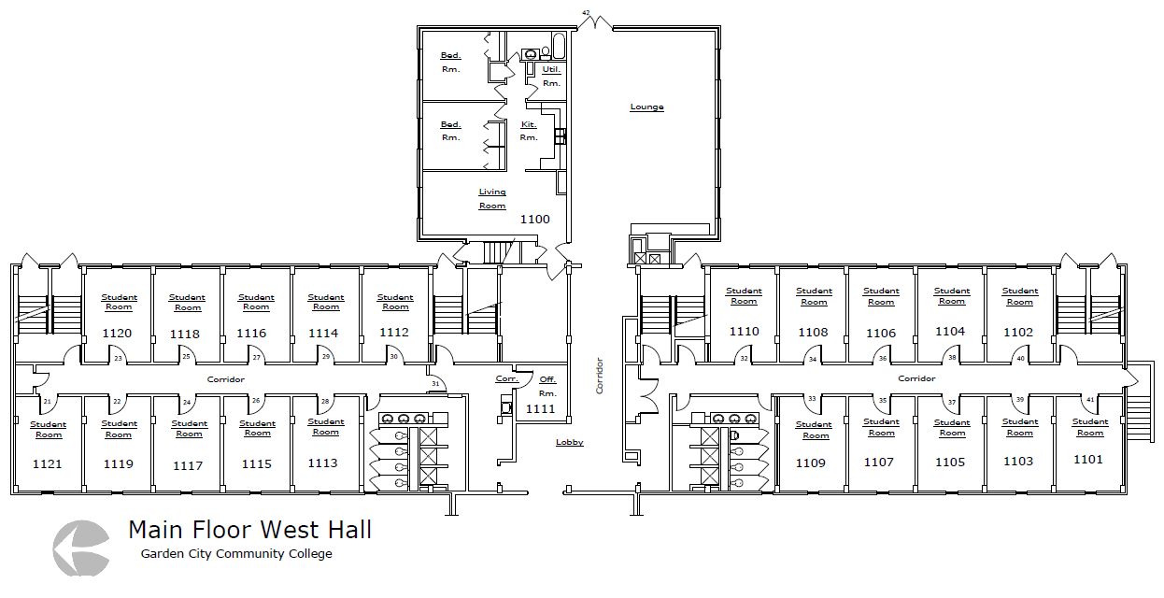

Slide 36
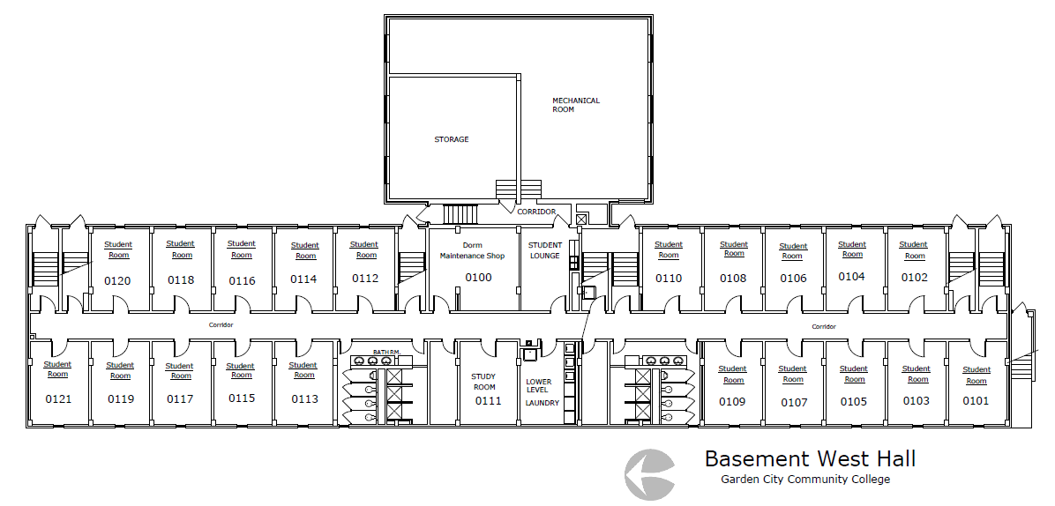

Slide 37
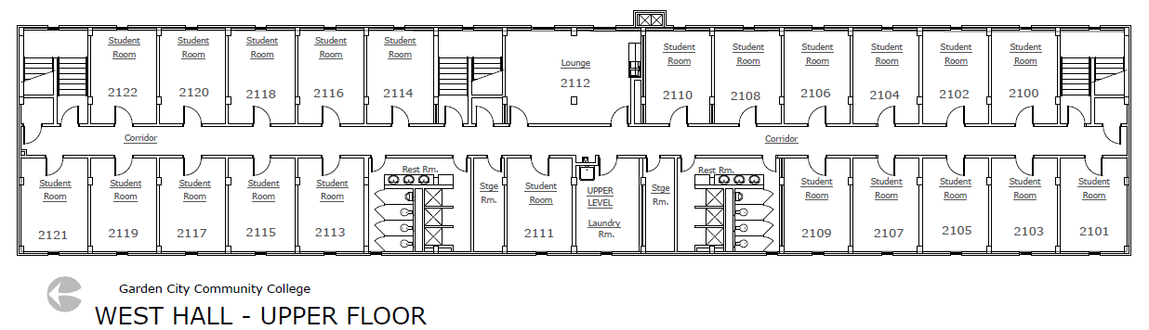

Slide 38
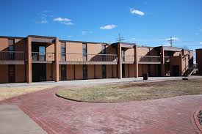
East Dormitory Complex
East Units
Constructed 1978 – 17,986 sq. ft.
Contains 14 apartments on two floors – each apartment has four rooms, a large bathroom and a lounge area. Apartments are approximately 11 X 15. 165 total square feet. Apartments! 1 and 2 are designed to accommodate handicapped. Planned occupancy was 112 students but is capable of housing 96 students. Two apartments used for offices, apartment 3 is the headquarters of the athletic department apartment 4 houses school nurse. Athletics and school nurse because there is no adequate space elsewhere on campus
2002 – Remodeled bathrooms and installed kitchenettes – plumbing and electrical upgrades
2002 – Re-roofed dorm and lounge building
2011 – Installed new fire alarm system New 4100ES
2021 – Installed new irrigation system and sod in the courtyard.
2021 – Removed brick pavers and installed new 4” concrete sidewalks

Slide 39
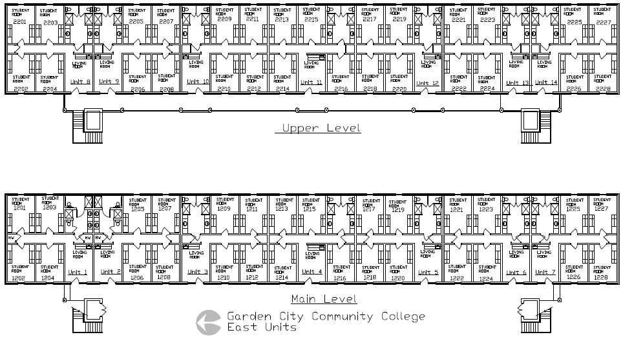

Slide 40
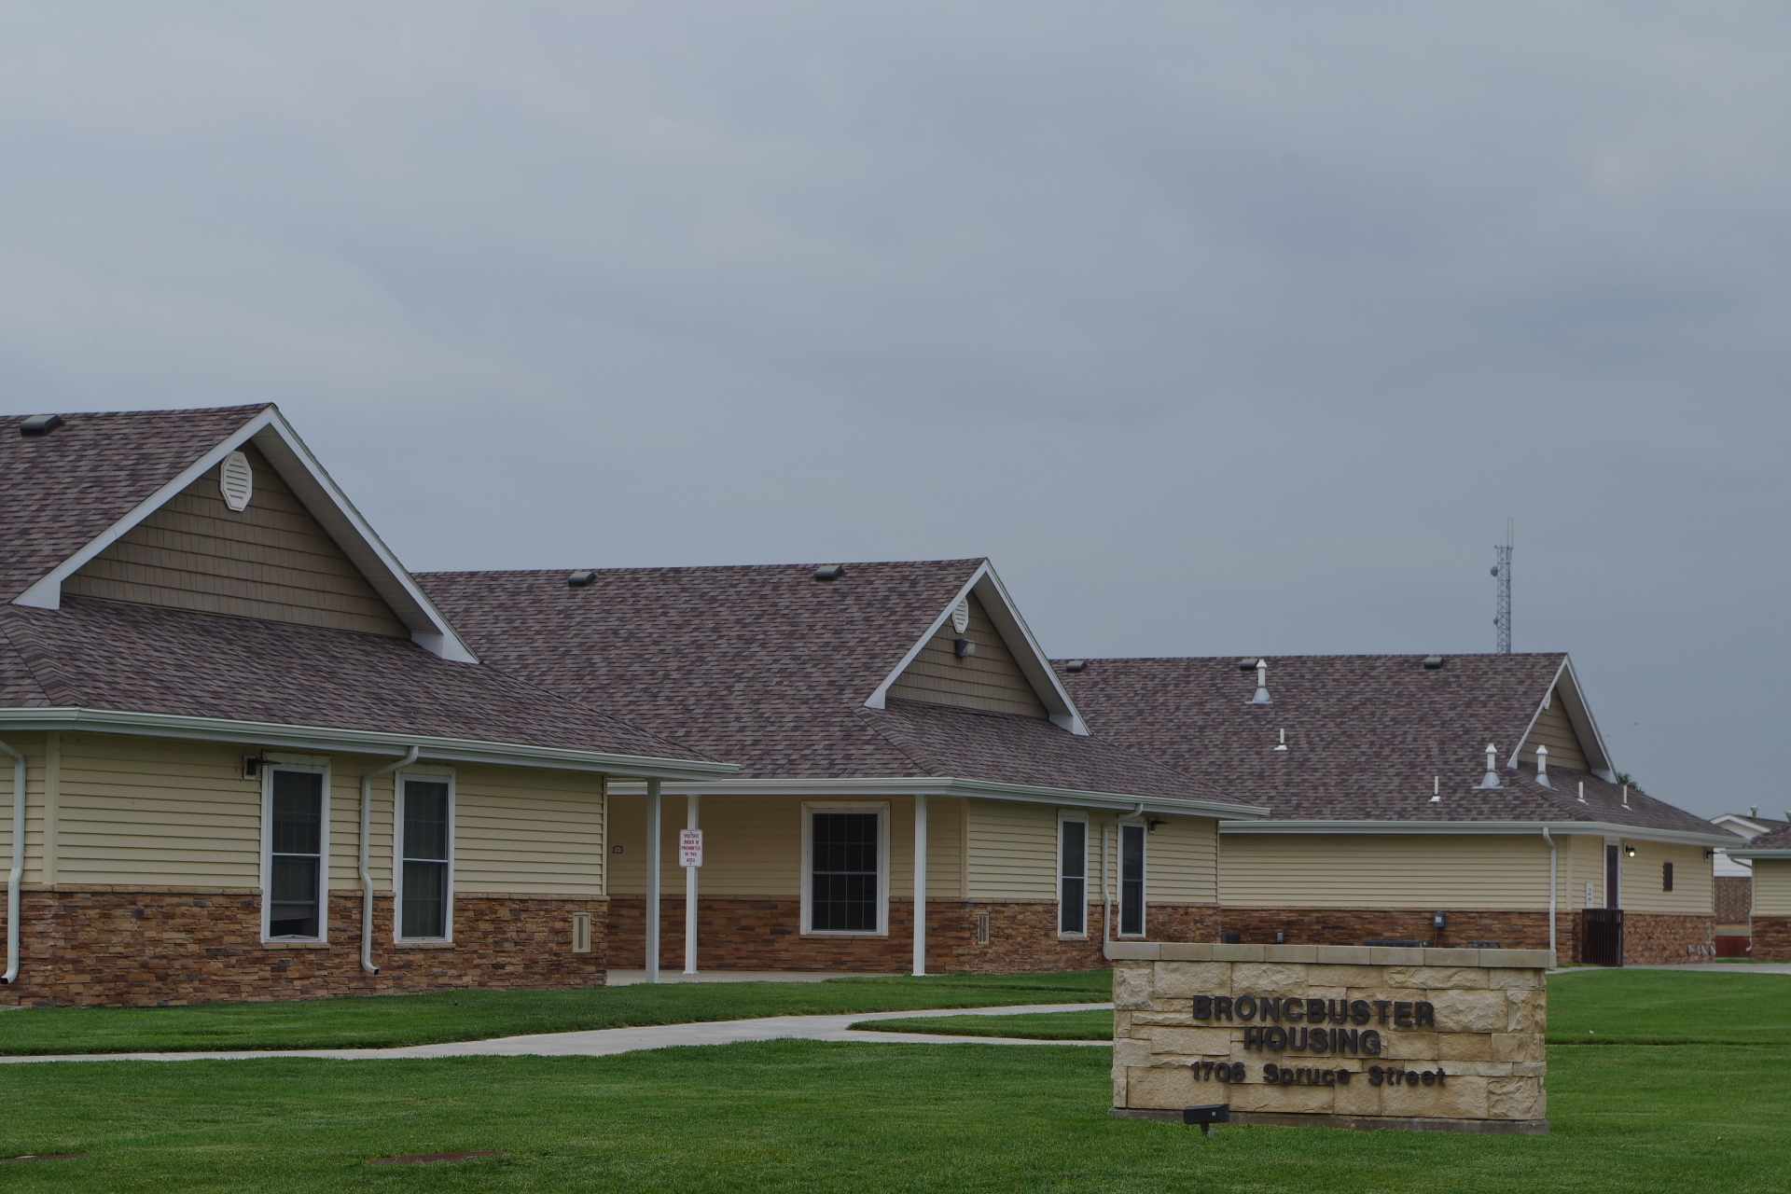
Broncbuster Housing
Broncbuster Housing 18,278
Constructed 2015 – 18,278 sq. ft. total
9 separate housing units –
8 units houses 64 students
1 unit- residential life supervisor/laundry and tornado shelter
1.93 acre lot

Slide 41
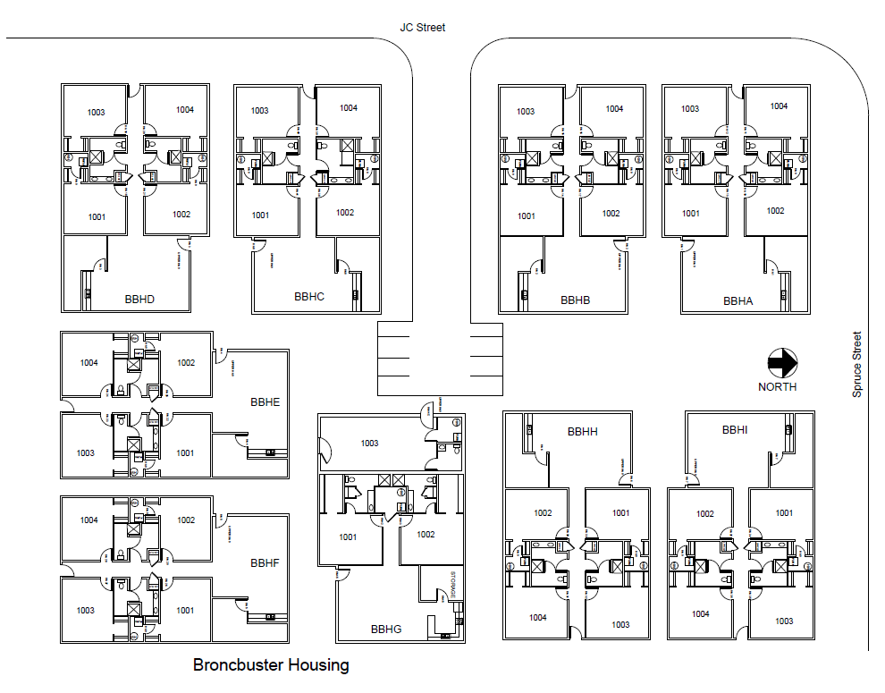

Slide 42
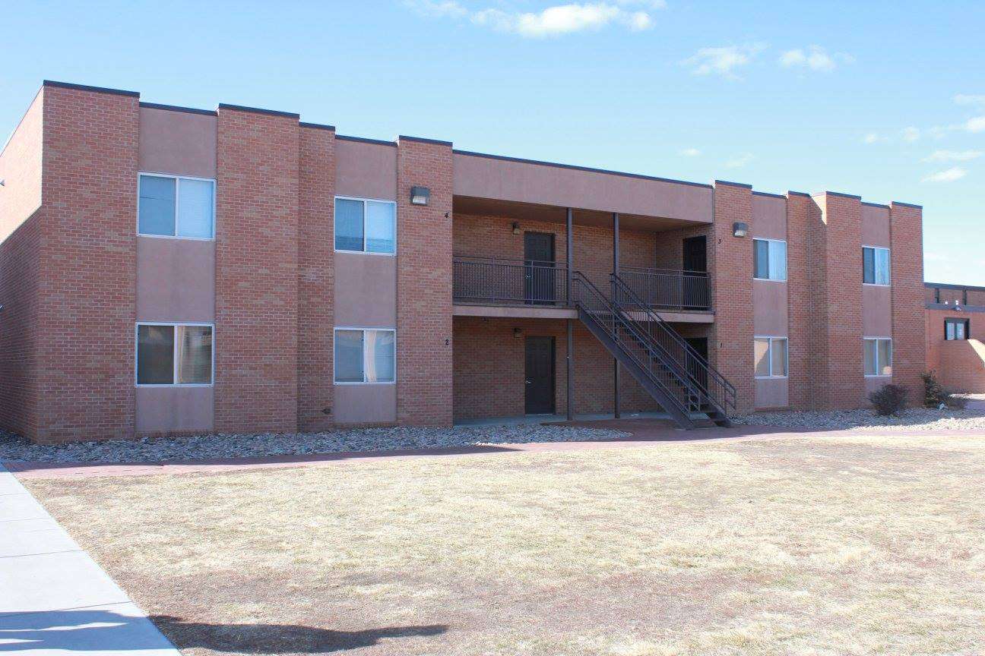
GCCC Apartments
Apartments
Constructed 2002
Four apartments per building
  Building A – 2,851 sq. ft.
  Building B – 2851 sq. ft.
  Building C – 2851 sq. ft.
2020 – Installed new Dryvit on all exterior windows on Apartment B

Slide 43
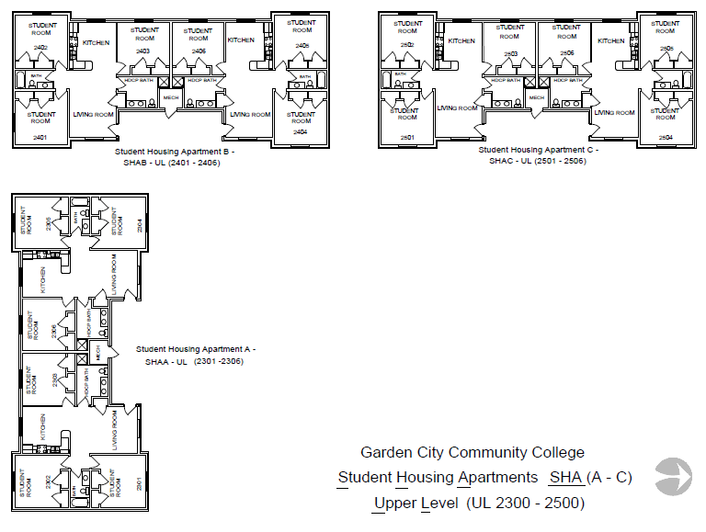

Slide 44
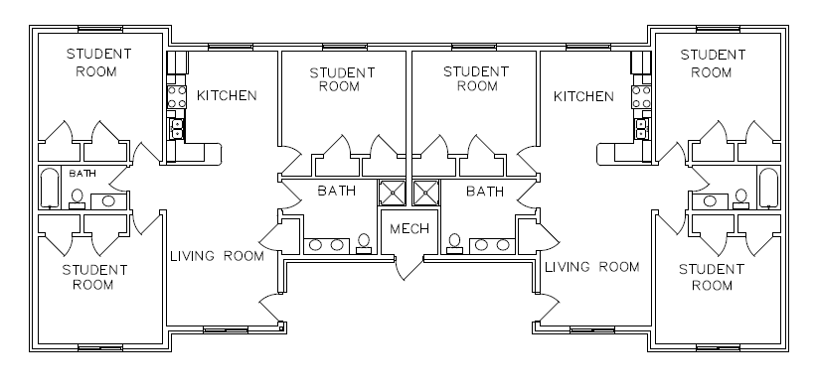

Slide 45
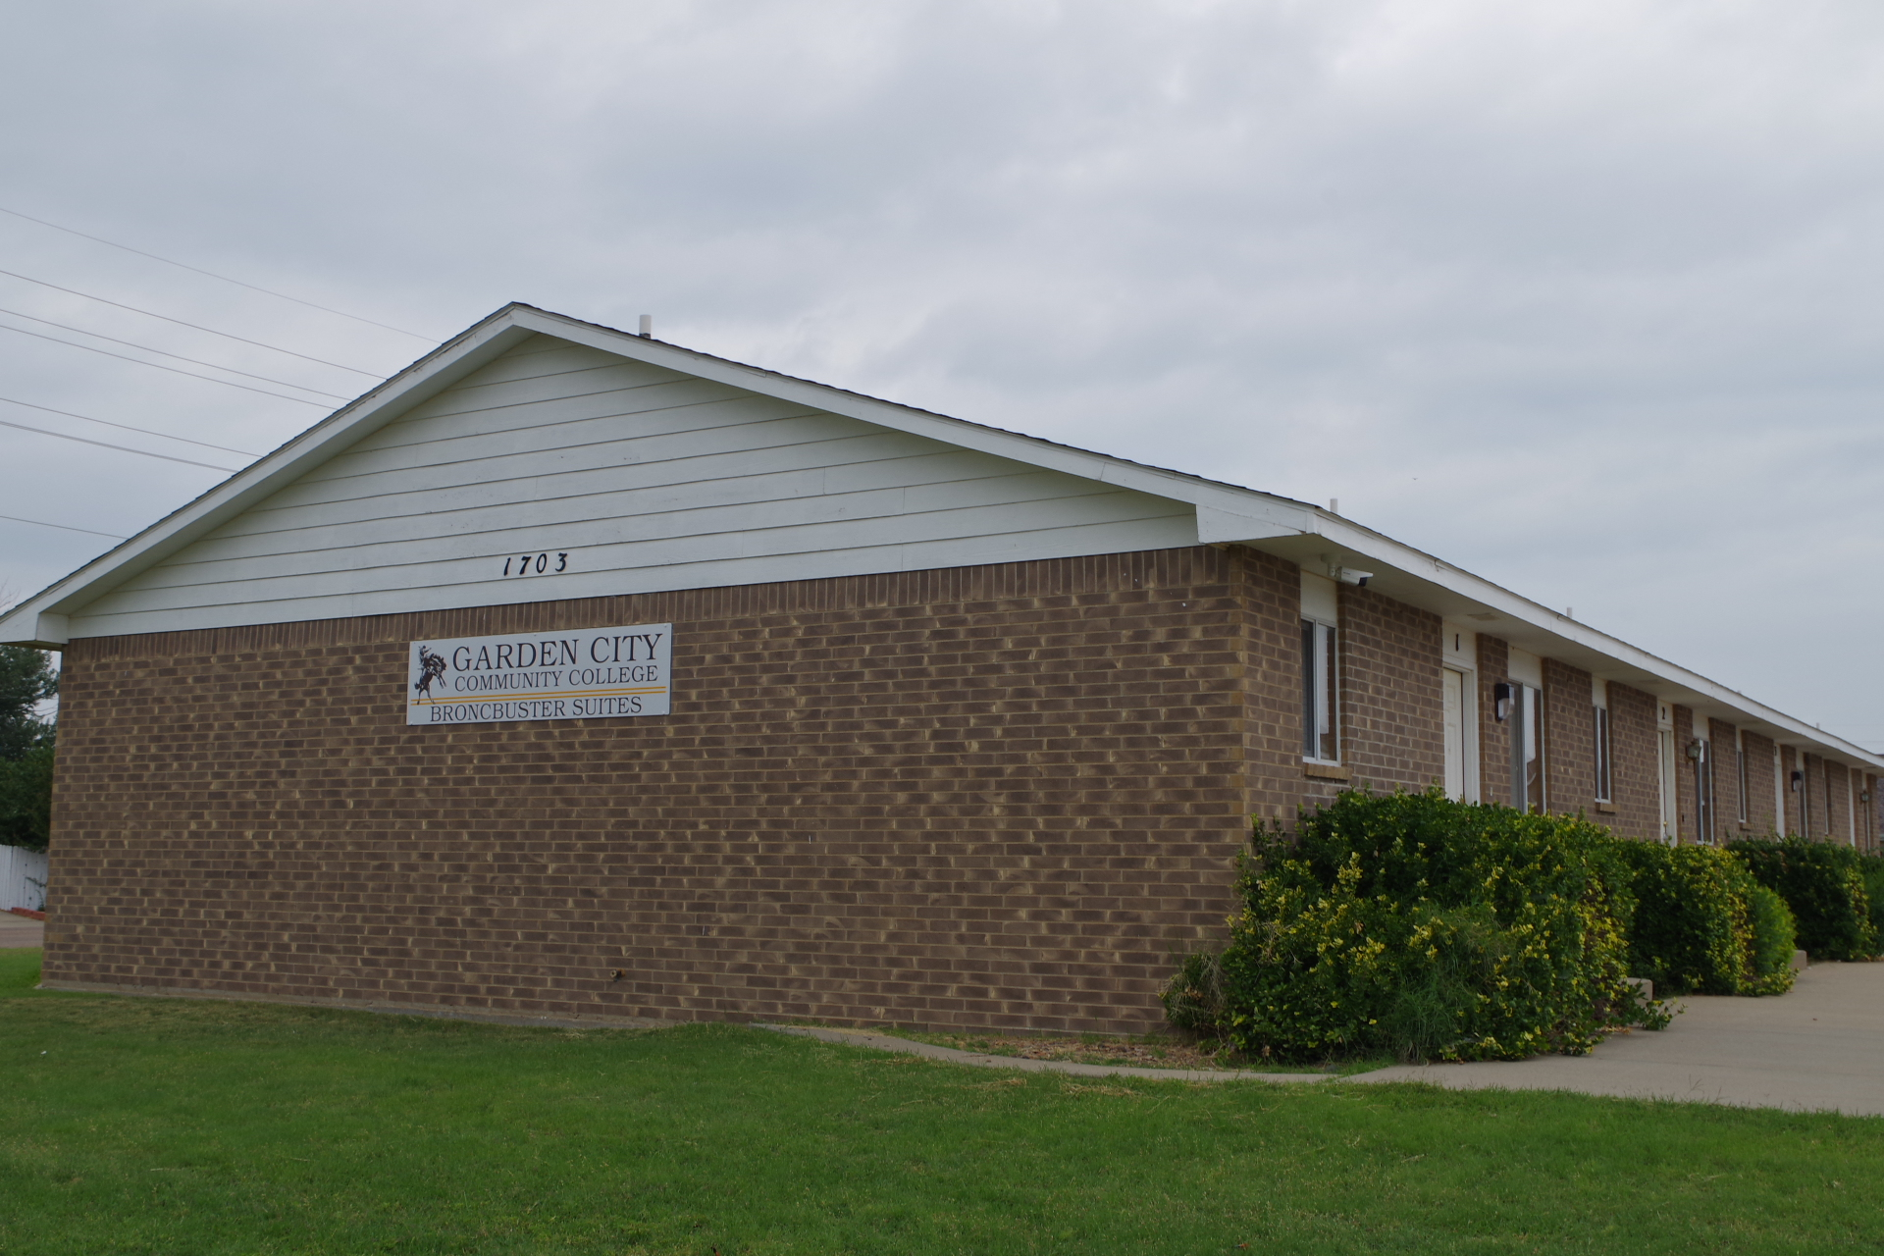
Broncbuster Suites
Suites
Constructed in 1995
Eight Buildings total
  Four east buildings purchased in 2016
  Four west buildings purchased in 2017
The eight buildings house 52 total apartments.

Slide 46
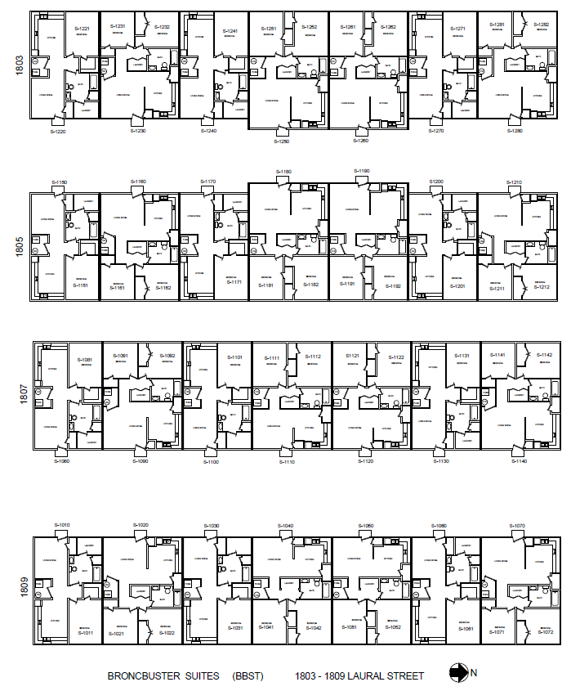

Slide 47
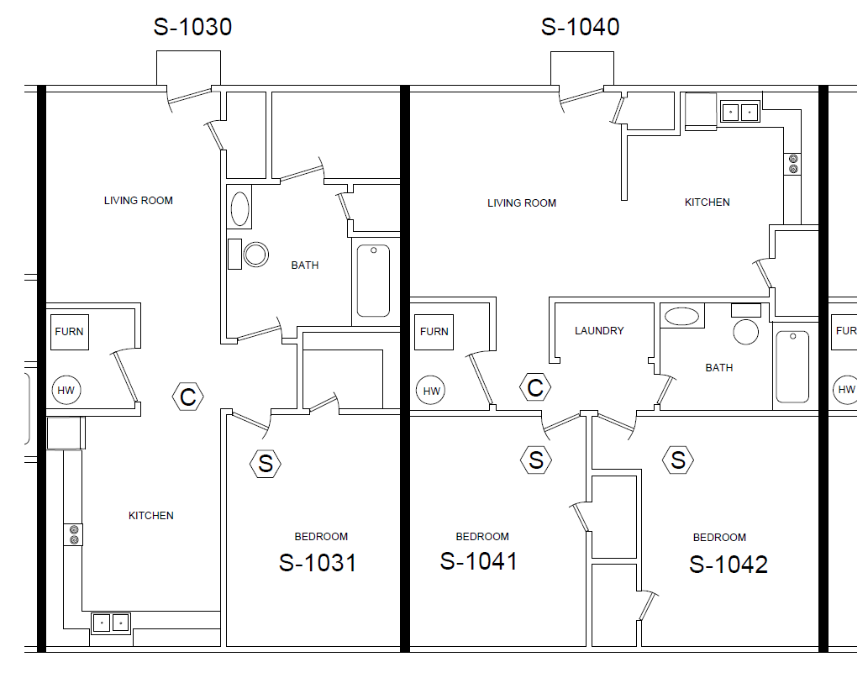

Slide 48
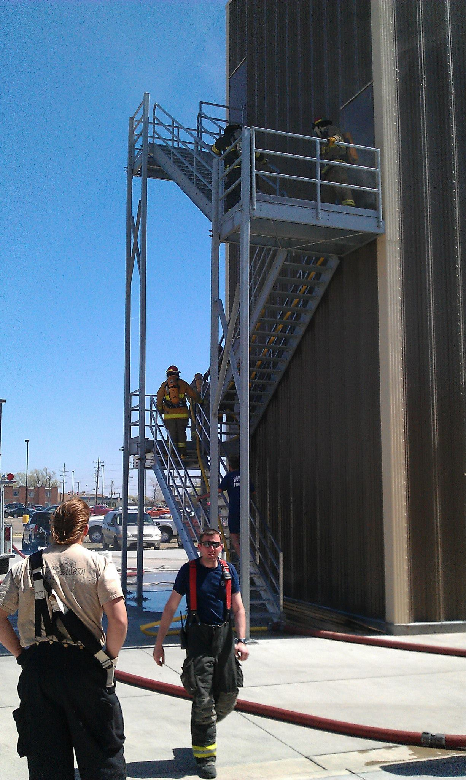
Southwest Kansas Fire Training Center
Constructed 2007 in conjunction with City of Garden City
GCCC paid $303,700 towards the project
3,200 sq. ft.

Slide 49
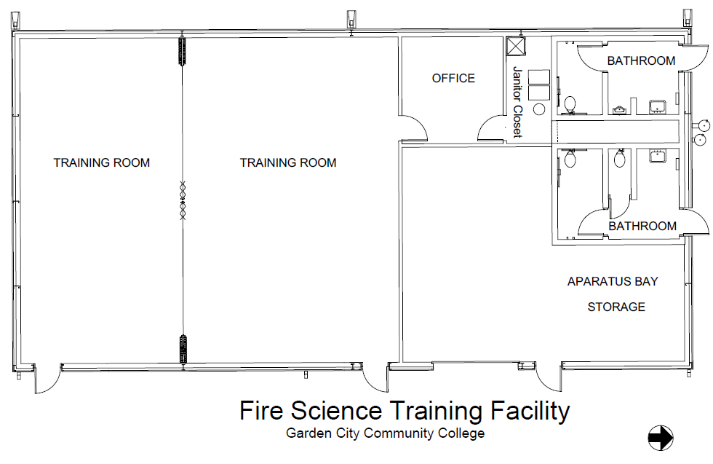

Slide 50
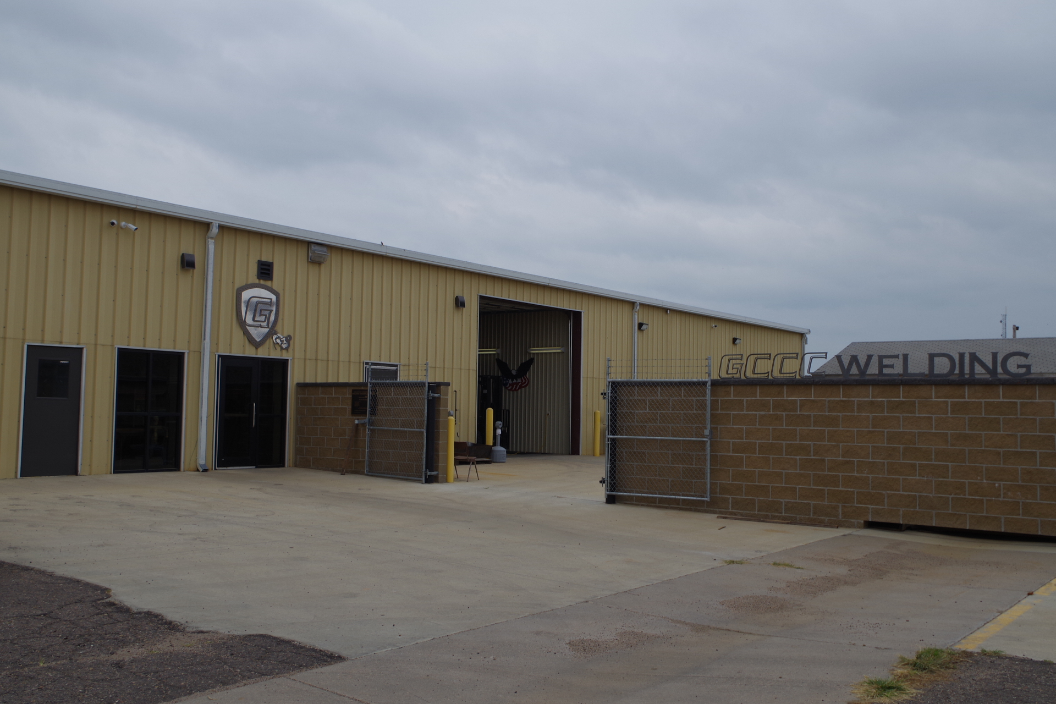
GCCC Welding
1802 E Spruce - Welding Center/National Guard
Acquired 2012
2015 – Back South section Remodeled for welding classroom,
2016– Front North section Remodeled for National Guard partnership with GCCC

Slide 51
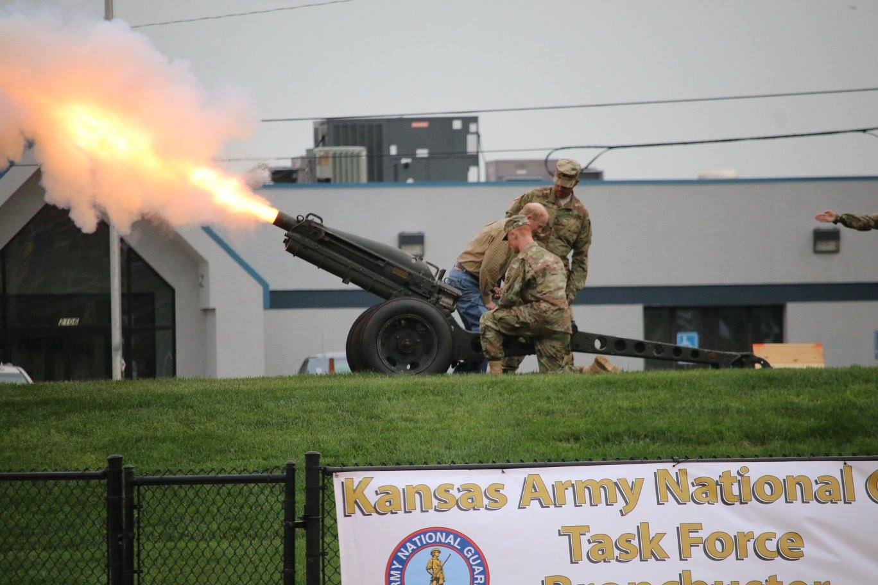
National Guard partnership with GCCC-Task Force Broncbuster
The cannon is a World War II M8 PACK Howitzer cannon, and will be discharged after the National Anthem and when the home team scores. The cannon is fired by members of the Kansas Army and Air National guard

Slide 52

GCCC/National Guard
Two Black Hawk helicopters piloted and crewed by Kansas Army National Guard Soldiers flew from the Army Aviation Facility #2 in Salina to GCCC for an orientation flight, March 30, 2017. The flight marked another celebration of the unique partnership between GCCC and the Kansas Army and Air National Guard. The Task Force Broncbuster partnership is the first of its kind amongst community colleges in Kansas.

Slide 53

Broncbuster Band Building
Broncbuster Band – 2106 E Spruce
Acquired 2014 – 4,200 sq. ft.
2017 – Remodeled by GCCC maintenance for band program

Slide 54


Slide 55


Slide 56

GCCC BRONCBUSTER STADIUM
Constructed 2013
2014 - Garage converted into concession stand
2016 – 4,000 sq. ft. Maintenance building constructed

Slide 57

Williams Stadium
Constructed in 1988
2005 light poles refurbished with new lighting
2018 Center left light pole new pole base poured.
2021 installed eight new 80 ft poles
A total of 128 high efficiency Led lights
Greatly improved visibility on the field and energy efficiency
Lower operation costs
Less light pollution in the neighborhood

Slide 58


Tangeman Sports Complex

Slide 59

Campus HVAC
Energy Center & Cooling Towers
1200 Tons of cooling Capacity
Increased energy efficiency
Lower operating cost
Campus Energy Center upgrade allows system to run only when needed

Slide 60
Master Facilities Plan
Developed by the Dean of Physical Planning & Facilities Management. Information gathered over a 8-year period.
  Internal Stakeholder input
    Advisory Boards
    Staff meetings
    Facilities Department
    IT Department
    Campus Police department
    Campus walk-throughs to gather information from Faculty, Staff and students.
  External Stakeholder input
    Contractors' meetings
    Vendor's meetings
    Architectural Firm
    Engineering Firms

Slide 61
Master Facilities Plan (Continued)
Planning over the years has included numerous stakeholders including advisory boards, community retreats, staff meetings and information received from the state and local leaders.
Deferred maintenance reports were prepared by the Operations Department.
Funding for projects is available through a variety of sources including, but not limited to general fund, capital outlay, private donation, federal grants and financing. The biggest challenge facing the college today is predicting future revenues, due to fluctuating oil and gas assessments, tax abatements and below predicted revenues at the state level, as well as student enrollment.
College buildings range in age from 5 years to 55 years. Although the college has not always had a formalized written deferred maintenance plan or master plan, focus has always been on maintaining current facilities and developing existing facilities to respond to educational needs in the region.

Slide 62
Master Facilities Plan (Continued)
In addition to routine maintenance and building renovation, when needed, the college has focused on the replacement of systems. The first project included updating and/or replacing fire alarm systems in campus buildings. That project began in 2007 and continued through 2013 when all systems had been replaced. Fire alarm systems are now evaluated with each building construction or remodel. The current systems have a life expectancy of twenty years or more. Rotational replacement will begin again in 2027. The fire alarm system is being integrated into the access control system in Jan 2021.
Attention was given to campus parking lots. Most lots were asphalt and beyond repair. A systematic plan was developed to replace asphalt parking lots with concrete as funds were available. The project began in 2014 and continued through 2017. The first parking lot replaced was the Fine Arts parking lot in 2014. SAFL Library parking lot was replaced in 2015. DPAC parking lot followed in 2016. The dormitory parking lot was replaced in 2017. Only two smaller asphalt lots remain on the college campus, GCCCA parking lot and the Welding parking lot. Both are in serviceable condition; however, plans have begun to replace welding parking lot in the next 1-3 years.
Focus has also been placed on roof replacement. Although repairs occur as needed, there is a systematic plan to replace all gravel roofs with a PVC membrane overlay and to put each roof on a 20-year replacement schedule. The library roof was replaced in 2017 along with the front lobby roof of the DPAC building. In 2018, north Penka roof, the west Fine Arts roof, east DPAC roof and the south JCVT roofs were all replaced by DV Douglass Roofing Inc. In 2019 we replaced sections of the Fine Arts, JCVT and portions of the DPAC roof. In 2021 further portions of the DPAC roof were replaced along with the entire shingle roofing for the GCCC Suites. The remaining roof replacements have been prioritized through meeting with roofing vendors and will be replaced as funds are available. It is anticipated the project will take approximately 2-5 years to complete depending on funding.

Slide 63
Master Facilities Plan (Continued)
Additionally, an evaluation of the underground tunnel system has been conducted. As of 2021 we have completed three phases of replacement of the hydronic piping system and tunnel caps throughout campus. Phase 1 was 800 feet of the north tunnel cap and 800 feet of the hydronic hot water pipe were replaced in 2017 by JAG construction. In 2019 we completed Phase 2 south tunnel cap and hydronic hot water pipe along with a section of piping and tunnel cap just south of DPAC. In 2021 we replaced the entire quad tunnel cap system along with 1,225 feet of hydronic piping. We added to drainage wells, as well to improve drainage on the quad. Stamped colored concrete was added in the center to improve aesthetics.
The next project we coordinated with the City of Garden city and focused on the evaluation, repair and replacement of campus streets and sidewalks. We completed crack sealing oil/chip overlay of all campus streets in 2019. We are scheduled for phase 2 in 2022.

Slide 64
Master Facilities Plan (Continued)
In 2021 we were granted board approval for new construction to add a Transit Center that will house the GCCC Bus Fleet as well as office space for Operations: (Maintenance, Transportation, Information Technology, Grounds, Custodian).
In 2021 we also purchased a new Freightliner 51 passenger Bus.
2021 – Network Switch replacement project was completed to update all campus switches.
Access control project for some exterior campus doors began at the end of 2020. Implementation of this project was completed in January 2021 with phase 2, all exterior doors, being completed in 2021. Plans are in place to being Phase 3 when funds become available.

Slide 65
Master Facilities Plan (Continued)
19 Light poles for campus have been installed in 2019 and 2021to improve campus safety and to complement our campus aesthetic. Three additional light poles will be installed in 2022.
Classroom technology (Camera, microphone and TV) has been installed to add to the remote learning capabilities of our campus classrooms.
Plans were developed and implemented in the beginning of 2021 to replace the two existing cooling towers and add an additional 300-ton chiller in summer 2021.
Building controls were also installed in the GCCC Energy Center in 2021 with plans to bring in all campus buildings on to the same system in 2022.

Slide 66
Master Facilities Plan (Continued)
Energy audits have been done in the past and have shown the need to replace the older and least efficient windows in all campus buildings. This project will be phased in and will save significant yearly expenditures on energy. Preliminary quotes have given us budget numbers and plans are in place to begin phase 1 in 2022
The existing domestic water piping in many campus buildings have reached the end of their service life. Plans to begin replacement have been put into place with the West hall being the first location.

Slide 67
Master Facilities Plan (Classroom Space)
Throughout this process we have identified major needs for additional classroom space. We have begun looking at options to expand current building space or to construct a new building to provide additional classroom space.
  Our campus is severely limited in classroom space. We are in need for future expansion. Through meetings with architectural firms and engineers we are identifying practical ways to expand through additions to buildings or new construction.

Slide 68
Master Facilities Plan (STEM success center)
In addition to classroom space, the college has the need for student learning and tutoring space, as well as a new Science, Technology, Engineering and Math (STEM) space. Fouse also has a need for additional lab space. Plans for future expansion have begun.
  STEM Success Center would include the following:
    Spaces for exploring the various aspects of STEM and diver deeper into each subject.
    Areas for tutoring and lecture space
    Expanded lab space as well as traditional and online classroom.

Slide 69
Operations Deferred Maintenance Schedule
Maintenance Plan
5-10 year plan
Windows |  |  |  |  |  | Estimated Cost
 | 2022-2023 | Admin, FOUS, ACAD |  |  |  |  | $75,000/yr
 | 2024-2026 | DPAC/Broncbuster Suites |  |  |  |  | $75,000/yr
 | 2027-2028 | Penka/Fine Arts/East Units |  |  |  |  | $75,000/yr
Roof Replacement |  |  |  |  |  | Estimated Cost
 | 2021-2022 | Broncbuster Suites w/ridge vents, soffit, fascia |  |  |  |  | $200,000/yr
 | 2023-2024 | BTSC Gravel Roofs |  |  |  |  | $100,000/yr
 | 2025-2026 | West Hall, East Units, Apartments |  |  |  |  | $300,000/yr
Tunnel Cap Replacement |  |  |  |  |  | Estimated Cost
 | 2021-2022 | Main Quad |  |  |  |  | $150,000/yr
 | 2023-2024 | JCVT East sidewalk |  |  |  |  | $100,000/yr
Hydronic Hot Water Pipe Replacement |  |  |  |  |  | Estimated Cost
 | 2021-2022 | Main Quad |  |  |  |  | $100,000/yr
 | 2023-2024 | JCVT |  |  |  |  | $75,000/yr

Slide 70
Operations Deferred Maintenance Schedule
Maintenance Plan
5-10 year plan
Access Control |  |  |  |  |  | Estimated Cost
Phase 1 | 2021-2022 | Main exterior doors |  |  |  |  | $150,000/yr
Phase 2 | 2021-2022 | Complete exterior doors |  |  |  |  | $100,000/yr
Phase 3 | 2022-2023 | Campus interior doors & Individual door rooms |  |  |  |  | $200,000/yr
Security Cameras |  |  |  |  |  | Estimated Cost
 | 2021-2022 | Main Quad |  |  |  |  | $15,000/yr
 | 2023-2024 | Interior Hallways |  |  |  |  | $20,000/yr
 | 2025-2026 | New construction and additional blind spots |  |  |  |  | $10,000/yr
Carpet (Seven-year life cycle) |  |  |  |  |  | Estimated Cost
 | 2016-2017 | Presidents Lobby |  |  |  |  | $10,000/yr
 | 2018-2019 | JCVT Classrooms |  |  |  |  | $10,000/yr
 | 2020-2022 | SAFL |  |  |  |  | $12,000/yr
Plumbing (Domestic Water) |  |  |  |  |  | Estimated Cost
 | 2022-2023 | West Hall |  |  |  |  | $100,000/yr
 | 2024-2025 | DPAC/Broncbuster Suites |  |  |  |  | $150,000/yr
 | 2026-2027 | SAFL |  |  |  |  | $100,000/yr

Slide 71
Operations Deferred Maintenance Schedule
Maintenance Plan
5-10 year plan
Campus Doors |  |  |  |  |  | Estimated Cost
 | 2021-2022 | East Units/West Hall |  |  |  |  | $15,000/yr
 | 2023-2024 | East Units/West Hall |  |  |  |  | $15,000/yr
 | 2025-2026 | DPAC/JCVT/SAFL |  |  |  |  | $15,000/yr
Chiller/Cooling Tower repalcement |  |  |  |  |  | Estimated Cost
 | 2021-2022 | Cooling tower replacement |  |  |  |  | $230,000/yr
 | 2021-2022 | Ammonia Chiller removal |  |  |  |  | $50,000/yr
 | 2022-2023 | Additional Freon Chiller |  |  |  |  | $500,000/yr
Ductwork Replacement |  |  |  |  |  | Estimated Cost
 | 2022-2023 | Fine Arts |  |  |  |  | $20,000/yr
 | 2023-2024 | JCVT |  |  |  |  | $20,000/yr
 | 2025-2026 | DPAC |  |  |  |  | $20,000/yr
HVAC Units upgrade |  |  |  |  |  | Estimated Cost
 | 2023-2024 | SAFL/ACAD/FOUS |  |  |  |  | $75,000/yr
 | 2024-2025 | JCVT/Broncbuster Suites |  |  |  |  | $100,000/yr
 | 2026-2027 | Fine Arts/East Units |  |  |  |  | $75,000/yr

Slide 72
Operations Deferred Maintenance Schedule
Maintenance Plan
5-10 year plan
Parking Lots |  |  |  |  |  | Estimated Cost
 | 2022-2023 | Welding |  |  |  |  | $150,000/yr
 | 2024-2025 | GCCCA |  |  |  |  | $100,000/yr
 | 2026-2027 | East Campus Stadium Parking |  |  |  |  | $1,000,000/yr
Ceiling Tiles |  |  |  |  |  | Estimated Cost
 | 2022-2023 | Cafeteria/Food Service |  |  |  |  | $50,000/yr
 | 2021 | DPAC |  |  |  |  | $50,000/yr
 | 2024-2025 | Fine Arts |  |  |  |  | $50,000/yr
Emergency Lights |  |  |  |  |  | Estimated Cost
 | 2021-2022 | DPAC |  |  |  |  | $3,000/yr
 | 2022-2023 | Fine Arts |  |  |  |  | $3,000/yr
 | 2024-2025 | SAFL |  |  |  |  | $3,000/yr
Fire Extinguishers |  |  |  |  |  | Estimated Cost
 | 2021-2022 | Campus wide-Annually |  |  |  |  | $1,000/yr
 | 2022-2023 | Campus wide-Annually |  |  |  |  | $1,000/yr
 | 2024-2025 | Campus wide-Annually |  |  |  |  | $1,000/yr

Slide 73
Operations Deferred Maintenance Schedule
Maintenance Plan
5-10 year plan
Asbestos Removal |  |  |  |  |  | Estimated Cost
 | 2022-2023 | Fine Arts |  |  |  |  | $50,000/yr
 | 2023-2024 | Fine Arts/Library |  |  |  |  | $75,000/yr
 | 2025-2026 | Library |  |  |  |  | $50,000/yr
VCT Tile Removal |  |  |  |  |  | Estimated Cost
 | 2024-2025 | Fine Arts |  |  |  |  | $10,000/yr
 | 2025-2026 | Fine Arts/JCVT |  |  |  |  | $10,000/yr
 | 2026-2027 | JCVT |  |  |  |  | $10,000/yr
Fine Arts Auditorium upgrade |  |  |  |  |  | Estimated Cost
 | 2022-2023 | Rail System |  |  |  |  | $100,000/yr
 | 2023-2024 | Rail System |  |  |  |  | $100,000/yr
 | 2025-2026 | Fire Curtain |  |  |  |  | $50,000/yr
Ammonia Chiller Revival (if we choose to stay with ammonia) |  |  |  |  |  | Estimated Cost
 | 2022 | Clean out system, repair coils |  |  |  |  | $50,000/yr
 | 2023 | Replace electric panel |  |  |  |  | $20,000/yr
 | 2024 | Replace Heat Exchanger plates |  |  |  |  | $40,000/yr

Slide 74
Stakeholder Meetings
Jan 2016 – Facilities Director met with Scott Strom of 360 Engineering to go over campus infrastructure needs. Determined where to prioritize campus funding to meet needs of students and infrastructure.
Jan 2016 – College Personnel met with Steward Nelson of GMCN Architecture to go over Campus parking lot replacement plans. DPAC parking lot specs and RFP sent out.
Feb 2016 – College received bids from Builders Plus, LLC. and Lee Construction for DPAC parking lot replacement project. Bid awarded to Lee Construction.
Feb 2016 – Facilities personnel met with Video Insight to discuss campus video surveillance needs. Trial run was accepted to take place in facilities building.
Feb 2016 – College Personnel met with Dick Construction to discuss future campus signage

Slide 75
Stakeholder Meetings
Feb 2016 – College personnel met with Don Geier of 3G Electric to discuss electrical issues at East campus
Feb 2016 – Facilities Director met with Joe Reintjes of Knipp Energy Services to discuss campus energy issues. Campus energy audit investigation was placed on project list.
Mar 2016 – College personnel met with GMCN to go over future plans for a transportation building to house the fleet vehicles and mobile classroom.
Mar 2016 – Facilities Director attended MHEC Loss control workshop in St. Louis.

Slide 76
Stakeholder Meetings
Mar 2016 – Facilities Director met with Dale Vesta of Global Technical Services to discuss campus roof examinations.
Mar 2016 – College personnel met with GMCN to discuss East campus maintenance project.
Mar 2016 – College personnel met with Scott Renfro with Hellas Construction to go over turf repair and track lines at Broncbuster stadium
Apr 2016 – Facilities Director met with Lee construction to go over project details of the DPAC parking lot replacement and facilities parking lot replacement. Facilities parking lot project started in April 2016.

Slide 77
Stakeholder Meetings
Apr 2016 – Facilities Director met with C&C group to discuss UNC replacement and possible upgrade. Campus building controls future planning and prioritization.
Apr 2016 – College personnel met with GMCN to discuss east campus maintenance building project specifications and scope.
Apr 2016 – College personnel met with Blackhills Energy, Tatro plumbing and the City of Garden City Electrical dept. to go over the utilities for the purchase of the Wagner apartments.
May 2016 – Facilities director met with local plumbing vendors to discuss jet cleaning service on old campus plumbing lines. Due to the age of the plumbing lines Facilities director decided not to proceed with jet cleaning service.
May 2016 – College personnel met with GMCN to go over specs and budgeted funding for transportation building project.
May 2016 – College personnel met with Dale Vesta to go over project details of library roof.

Slide 78
Stakeholder Meetings
June 2016 – Facilities Director did a walkthrough with Stewart Nelson of GMCN Architects to discuss tunnel cap replacement from east of the street in front of JCVT to the Fouse BLDG and in front of the Fine Arts BLDG.
July 2016 – Facilities Director met with Bob Kreutzer of Tatro plumbing to discuss Hydronic water line replacement in the tunnels.
September 2016 – Facilities Director met with 360 Engineering to go over campus infrastructure. Prioritize HVAC control system upgrades.
October 2016 – Maintenance supervisor did a walkthrough of the tunnels with Tatro plumbing and Central Consolidated to have them bid for hydronic water line replacement.
October 2016 – Facilities Director and IT personnel completed a walkthrough with GMCN Architects to figure out a way to keep Hydronic water lines and IT Cables in place while tunnel cap is being removed.
November 2016 – Facilities Director met with JAG Construction & Lee Construction, doing a walkthrough of the tunnels and the residential life parking lot so they could get an idea of how they should bid both jobs. Tunnel cap replacement and Dorm parking lot projects.

Slide 79
Stakeholder Meetings
January 2017 – Facilities Director met with Pat Benefield with C&C group to discuss the enterprise server graphics workstation for the campus HVAC system. Also met with Terry Clark with Building Control Services.
April 2017 – Facilities met with Mike Morginson of JAG Construction to prepare for Tunnel cap replacement starting in May. We disconnected all sprinkler lines so they could drive along tunnel cap edges with heavy equipment without breaking water lines. Heavy equipment could be allowed just east of fine arts.
April 2017 – Facilities Director met with Jag Construction to access the dirt removal for the residential parking lot.
April 2017 – Facilities Director met with Stewart Nelson of GMCN on replacement of roofs. The library roof and DPAC roof over the lobby of DPAC were prioritized. Facilities requested a tapered system over the Library roof.
April 2017 – Facilities Director met with Justin Sanchez and Kelly Wright of Tatro plumbing to bid on HVAC and plumbing work to be done at the Band BLDG.
April 2017 – Facilities Director met with Marcus Ramos of Central Consolidated to bid on HVAC and plumbing work to be done at the Band BLDG.

Slide 80
Stakeholder Meetings
May 1, 2017 – Maintenance Supervisor met with JAG Construction as to where they can store all Construction materials to be used for residential parking lot project. Decision was made to allow them to place materials on the ropes course north of the fire tower.
May 16, 2017 – JAG construction found a natural gas leak on the gas line during deconstruction of the Res life parking lot. Facilities director communicated with Tatro Plumbing to repair. Also met with Susone Croslin with Black Hills Energy to discuss a 60LB. pressure check at which time a new leak was found. Facilities Director made decision to replace complete gas line otherwise we would be chasing leaks after each repair. Gas line was 50 years old. Communicated with Tatro Plumbing & Black Hills to replace with new line.
May 18, 2017 – Facilities communicated with Mike of JAG about raising the bottom side of the tunnel cap just east of the intersection of the Fine Arts BLDG. in order to have clearance for existing pipes. Mike agreed that would help him out considerably. Communication was done with Stewart Nelson GMCN and he agreed also.
May 21, 2017 – Facilities Director met with Tatro Plumbing and Central Consolidated for the Hydronic loop line replacement. Justin Sanchez and Kelly Wright were the contacts for Tatro. Bill Lorg was the contact with Central Consolidated.
May 23, 2017 – Facilities director brought Tatro Plumbing in to run a camera down the old sewer line under the Res Life parking lot to check the integrity of the old sewer line before being covered with new concrete parking lot. Camera found standing water. Communicated with L.A. Evans of GMCN and Justin of Tatro Plumbing. Facilities Director made the decision to replace.

Slide 81
Stakeholder Meetings
May 2017 – College personnel coordinated with JAG Construction. Water line leak was found west of the apartments B and C. Called Western Irrigation to consult and then to come and fix.
May 2017 – Found a leak on the Black Hills gas meter after getting new gas line replaced. Called Susone Croslin of Black Hills to let them know. Black Hills did replace.
May 2017 – Communicated with DV Douglass roofing and Weather Craft Roofing along with LA Evans project manager for GMCN Architects to discuss bidding on the Saffell Roof and the DPAC Lobby Roof.
May 2017 - Coordinate with Lankford Construction and LA Evans to demo bleachers in the gymnasium.
June 2017 – Communicate with 3G Electric Don Geier and have them convert the electric in the Wagner Apartments.
June 2017 – Facilities Director met with C&C group on project scope for the UNC upgrade project scope, dates/times and accessibility.

Slide 82
Stakeholder Meetings
June 2017 – College personnel communicated with 3G Electric to have them replace old floor receptacles with new in the gymnasium floor. Also included replacing old floor receptacle boxes with new.
July 2017 – Facilities Director met with LA Evans and Lankford Construction about raising the spiral staircases in the gymnasium in order to install the new floor underneath the staircases.
July 2017 – Facilities Director met with 3G Electric on obtaining a cost from them for doing electric work in the New Band building.
July 2017 – Maintenance supervisor met with the volleyball net contractor to get wiring ran to its installation point. 3G electric was called for installation.
Aug 2017 – Black Hills Energy was communicated with to have the gas meters installed at west part of the Wagner Apartments to be prepared for students for the upcoming year.
Aug 2017 – Facilities communicated with JAG Construction. Another water leak west of Apartments B and C. Western Irrigation was contacted and a decision was made for total replacement of old line. This way, we will not be digging up patio block to replace in the future.

Slide 83
Stakeholder Meetings
Sept 2017 – Facilities Director met Stewart Nelson of GMCN Architects. Dryvit deteriorated and fell off of Apartment A and exposing severe deteriorated metal I beams. Decisions were made to repair apartments A, B, and C at the second floor level as an emergency repair.
Sept 2017 – College personnel met with Mike Selzer of Dick Construction on the apartments and a plan of action was put into place on how the apartments were to be repaired.
Sept 2017 – Maintenance supervisor met with DV Douglass roofing about repairs to the Mercer Gallery and the room off to the side of the Theater in the Fine Arts Building. Communication was also done with DV Douglass Roofing about repairs to the Academic Building in the east hallway right above the entrance to the lecture classroom.
Sept 2017 – Maintenance supervisor met with Dick Construction to cut out concrete from the welding lab to the welding lab garage in order to wire up an extra air compressor.
Sept 2017 – Maintenance personnel communicated with 3G Electric for installation of wiring and adding alternating delay switches to brand new air compressors in the auto lab that controls air for tools in all of JCVT.

Slide 84
Stakeholder Meetings
Nov 2017 – Communicated with Darrell Hemmert of Hemmert acoustics to get a bid proposal to put in a ceiling in the New Band BLDG. and the EMT Classroom and EMT office.
Nov 2017 – Facilities Director met with local plumbing vendors to discuss campus student housing replacement of two large hot water heaters in the east units. Campus housing water heaters are old and need replacing. Plan to install all new water heaters in 5-7 years.
Dec 2017 – Facilities Director met with C&C group about upgrading the rest of the campus building controls. Prioritized building on need.
Dec 2017 – College personnel met with Tatro plumbing and Central Consolidated to go over future replacement of existing Hydronic HW pipe in the tunnel system.
Jan 2017 – College personnel met with Johnson controls to go over ammonia chiller revival plan. Prioritize the need for only one chiller revival at this time. If needed, the second ammonia chiller can be used for parts to save costs.

Slide 85
Stakeholder Meetings
Jan 2018 – Facilities director met with GMCN architecture to go over campus roofing replacement project. It was determined that the prioritized roofs in need of replacement were the remaining gravel roofs. This project would consist of the east DPAC roof, north Penka roof, west Fine Arts roof and south JCVT roofs.
Feb 2018 – Met with Weathercraft Roofing, DV Douglass roofing and Wray roofing to go over roofing project.
Feb 2018 – Facilities personnel completed RFP and specs with GMCN of roofing project for 2017
Feb 2018 – Facilities director met with GMCN architecture to go over the campus tunnel cap system. Determined that the south tunnel cap was a potential future safety hazard. Prioritized its repair/replacement as soon as possible.

Slide 86
Stakeholder Meetings
Mar 2018 – Facilities personnel completed the specs and RFP for the south tunnel cap replacement project. Waiting on administration to determine funding.
Mar 2018 – Facilities personnel met with Johnson controls to go over heat exchanger stainless steel plate replacement. Determined total replacement was needed to get ammonia chiller up and running
April 2018 – Facilities personnel met with Tatro plumbing to go over future campus plumbing needs. Prioritization on domestic water lines and sewer lines.
April 2018 – Facilities personnel met with C&C group to go over building controls on campus. Prioritization of campus buildings was conducted with the chiller plant and boiler room to be completed first. Depending on funding, whole campus building controls will be upgraded in 10 years.
May 2018 – College personnel went out for bid on south tunnel cap project and Hydronic HW pipe replacement. Received bids from Lee Construction, JAG Construction, Tatro Plumbing and Central Consolidated. Projects were stopped due to insufficient funding.

Slide 87
Stakeholder Meetings
Sept 2018 – Operations personnel met with NCS, CDW and C& C group for wireless access points and cameras. Operations completed the specs and RFP for the Wireless access points and cameras and were granted board approval in Oct 2018
Mar 2018 – Facilities personnel met with Johnson controls to go over heat exchanger stainless steel plate replacement. Determined total replacement was needed to get ammonia chiller up and running
April 2018 – Facilities personnel met with Tatro plumbing to go over future campus plumbing needs. Prioritization on domestic water lines and sewer lines.
April 2018 – Facilities personnel met with C&C group to go over building controls on campus. Prioritization of campus buildings was conducted with the chiller plant and boiler room to be completed first. Depending on funding, whole campus building controls will be upgraded in 10 years.
May 2018 – College personnel went out for bid on south tunnel cap project and Hydronic HW pipe replacement. Received bids from Lee Construction, JAG Construction, Tatro Plumbing and Central Consolidated. Projects were stopped due to insufficient funding.

Slide 88
Stakeholder Meetings
Mar 2018 – Facilities personnel completed the specs and RFP for the south tunnel cap replacement project. Waiting on administration to determine funding.
Mar 2018 – Facilities personnel met with Johnson controls to go over heat exchanger stainless steel plate replacement. Determined total replacement was needed to get ammonia chiller up and running
April 2018 – Facilities personnel met with Tatro plumbing to go over future campus plumbing needs. Prioritization on domestic water lines and sewer lines.
April 2018 – Facilities personnel met with C&C group to go over building controls on campus. Prioritization of campus buildings was conducted with the chiller plant and boiler room to be completed first. Depending on funding, whole campus building controls will be upgraded in 10 years.
May 2018 – College personnel went out for bid on south tunnel cap project and Hydronic HW pipe replacement. Received bids from Lee Construction, JAG Construction, Tatro Plumbing and Central Consolidated. Projects were stopped due to insufficient funding.

Slide 89
Campus Improvement Success
2007
Remodeled faculty offices in the Academic Building and installed new furniture
Purchased new tables and chairs for classrooms in the Academic Building and the Pauline Joyce Fine Arts Building
Installed new carpet in the lobby and meeting rooms in the student center
Remodeled volleyball, softball and women’s basketball locker rooms
Installed new carpet in the athletic offices and the Hall of Fame Room
Completed the hot water project by tying the athletic complex to the heating/cooling loop
Constructed burn tower and classroom for the Fire Science Program.
Purchased new furniture for the hallways in JCVT and Penka Building
Added 2 locker rooms in DPAC (WBB & Softball)

Slide 90
Campus Improvement Success
2008
Replaced roof on Warren Fouse Science and Math Building
Major repairs were completed on several roofs
Installed one replacement boiler and one new boiler
Converted masonry lab to welding shop
Replaced ticket booth and remodeled entrance to Dennis Perryman Athletic Complex
Painted and refinished main gym floor
Replaced floor tile in the John Collins Vocational Technical Building (JCVT)
Modified restrooms to meet ADA requirements in the JCVT
Renovated and expanded Director of Residential Life’s apartment
Remodeled area for two efficiency apartments
Installed power supply backup and upgraded electrical wiring in the server room
Constructed fire tower and classroom (partnership with City of Garden City)

Slide 91
Campus Improvement Success
2009
Installed new exterior lights and poles in the athletic complex parking lot
Installed new fire alarm systems in the John Collins vocational Building, Fouse Science and Math and the Penka Building
Relocated and updated the Journalism Lab
Added Cox Medial Lab to include television and radio studios
Installed two new automotive lifts in the Automotive Program Lab
Replaced gas kiln and converted storage space into electric kiln room
Constructed simulation lab and classroom as an addition to the Penka building.

Slide 92
Campus Improvement Success
2010
Conducted major renovations to the classrooms, laboratories and restrooms in the Warren Fouse Science and Math Building
  Replaced exterior windows
  Installed new airlock entryways
  Upgraded lighting, ventilation, ceilings, walls and floor coverings
  Installed new fixed seating in classrooms and lecture hall
  Widened doorways to meet ADA compliance
  Equipped classrooms with current technology
Installed new fire alarm system in the West Hall residential life

Slide 93
Campus Improvement Success
2010
Remodeled faculty offices in the Pauline Joyce Fine Arts Building and installed new furniture
Updated the child care center and director’s office with new paint and furniture
Upgraded the sound system in the main gymnasium
Renovated the baseball academy by updating the lighting and heating. Installed a new netting system and replaced exterior door.
Upgraded lighting and heating
Installed new metal roofs on the press box and dugouts at Tangemen Field

Slide 94
Campus Improvement Success
2011
Installed new fire alarm system in the east unit residence halls
Installed new fence and scoreboard at Williams Stadium
Installed new dishwasher in the kitchen along with plumbing and electrical upgrades
Acquired property at 722 & 724 Campus Drive
Razed house at 722 Campus Drive
Installed new exterior doors at the main entrance to the Dennis Perryman Athletic Complex
Installed new airlock entryway with new exterior doors to the south entrance of the athletic complex
Significantly improved network infrastructure and wireless connectivity across campus (Shriver trust)
Conducted major renovations to ACAD

Slide 95
Campus Improvement Success
2012
Renovated the old Administration Building including the Endowment Offices, President’s office and the conference room
Installed new electrical panels in the old Administration Building and the Academic Building
Conducted major renovations to offices, classrooms and restrooms in the Academic Building.
  Replaced exterior windows
  Installed new air lock entryways
  Upgraded lighting, ventilation, ceilings, walls and floor coverings
  Installed new fixed seating in the lecture hall
  Widened doorways to meet ADA compliance
Equipped classrooms with current technology

Slide 96
Campus Improvement Success
2012
Redesigned the Access and Opportunity Center to include 3 classrooms and several offices
Installed sod and irrigation in front of Residential Life and the Student Center
Installed new fencing around the yards of the Director and Assistant Director of Residential Life
Residential Life apartments and units received new tile along with new exterior and interior paint
Upgrades were made to offices and classrooms for the Criminal Justice, the Comprehensive Learning Center and the Saffell Library
Removed numerous dead trees and planted several new trees as part of the campus beautification initiative
Razed an old garage west of the Dennis Perryman Athletic Complex was razed.
Installed new netting and safety fences at Williams Stadium
Installed new energy efficient lights in the main gym and the practice gym
Purchased mobile classroom (Trac-7 grant)

Slide 97
Campus Improvement Success
2013
Remolded men’s basketball and football coaches offices and added new furniture
Purchased furniture for women’s basketball coaches’ office
Installed new fire alarm system in DPAC, SAFL, JOYC
Converted former storage room in athletic complex into study hall with mini-computer lab
Renovated classroom space into offices for the IT Director and programmers
Installed all-purpose athletic field to accommodate soccer, football and track programs
Razed rental property at 2316 Schulman
Purchased land at 1706 E Spruce and cleared area of structures and debris
Purchased 1802 E Spruce
Purchased indoor arena

Slide 98
Campus Improvement Success
2013
Redesigned animal science classrooms and laboratories and added new equipment with proceeds received from the TRAC 7 grant
Added artificial turf to the baseball batting cage
Repaired and replaced sidewalk trip hazards
Repaired street south of the athletic complex
Installed new water lines at the indoor arena
Trees were trimmed, diseased trees removed and new trees planted as part of the continuous campus beautification
Laser leveled, laid sod and replanted the baseball field at Williams Stadium
Remodeled ACAD east hall, added 2 offices and 2 classrooms, updated hallways and installed fire alarm system
Replaced library lobby carpet

Slide 99
Campus Improvement Success
2014
Replaced asphalt parking lot behind Fine Arts Building with concrete
Remodeled two classrooms in the John Collins Vocational Building
Installed energy efficient lighting in the woodshop, Super Circuit, weight room and the main gym
Constructed new 9-building student housing complex adding accommodations for 64 students
Replaced fascia on the Academic Building
Remodeled baseball offices and locker room, including the addition of individual shower stalls
Purchased new furniture for baseball, softball, golf, and soccer offices.
Installed new LED message sign on Campus Drive.
Additions to the new multi-sports complex include sidewalks, ticket booths, tailgate areas, signage and lighting
Remodeled and updated Assistant Director of Residential Life apartment
Remodeled portion of concession stand at Tangeman Fields into softball locker room

Slide 100
Campus Improvement Success
2015
Purchased 2016 E Spruce
Replaced asphalt Saffell Library parking lot with concrete
Converted ITV Classroom in Academic Building to regular classroom
Remodeled student center to include new meeting rooms, new student offices game room and internet café
Relocated college bookstore to main floor of student center
Renovated and modernized residential life offices, lobby and student television room
Renovated unoccupied building to state of the art welding lab, classroom and offices
Extensive renovation to the athletic complex lobby to improve functionality and modernize the area

Slide 101
Campus Improvement Success
2016
Replaced the asphalt parking lot at the athletic complex with concrete
Upgraded the bus parking lot from asphalt to concrete
Constructed a maintenance building at the multi-sport complex
Purchased four apartment buildings, contiguous to campus. The buildings provided beds for an additional 88 students (17030-01713 E Laurel
Remodeled space to accommodate the Kansas National Guard Training Center
Replaced floors, repaired drain line and completed other maintenance at East Garden Village classroom.
Replaced water circulating pump in DPAC

Slide 102
Campus Improvement Success
2016
Repacked seals in the cooling tower pump
Refurbished break room/kitchen in cosmetology
Renovated the Director of Residential Life’s apartment
Installed new sprinkler system and sod at Broncbuster Housing
Upgraded and expanded the campus phone system software
Upgraded the college network infrastructure to expand network capabilities
Refurbished the Allied Health laboratory classroom
Relocated the testing center from the library to the Student and Community Service Center

Slide 103
Campus Improvement Success
2017
Replaced the asphalt parking lot south of the student center
Replaced sewer pipe and gas line running under student center parking lot
Replaced hydronic pipe and tunnel camp on sidewalk running east west in front of Fine Arts Building.
In coordination with the City of Garden City, a crosswalk was installed across Campus Drive to connect main campus and athletic complex
Installed mechanical controls to more efficiently control HVAC system
Installed backup hardware device to ensure business continuity in the event of a system outage
Installed new firewall to protect college data
Replaced outdated storage area network to eliminate periodic outages
Purchased an additional four apartment buildings, contiguous to campus. The buildings provided beds for an additional 80 students.
Refurbished apartments at Broncbuster Suites as necessary for occupancy

Slide 104
Campus Improvement Success
2017
Substantially reinforced concrete balconies at three student apartment buildings
Replaced Saffell Library roof
Replaced portion of DPAC roof
Re-commissioned ammonia chiller
Replaced 3 100-gallon hot water heaters
Replaced 2 sump pumps in basement of SCSC
Campus phone system was updated and VOIP phones installed in SCSC
Software for E-911 was updated
Remodeled existing building to accommodate the band program
Renovated competition gym by replacing wood floor and installing new bleachers and volleyball net
Purchased vacant lot at 510 N Campus Drive
Replaced water line and tunnel cap between vocational building and Fouse Building.

Slide 105
GCCC Campus Property
Campus Property Acres
Main Campus Grounds 60.54
ROPES Course & Southwest Kansas Fire Training Center 3.5
Williams Stadium 2.75
Campus Sand Pit Grounds 83.93
East Campus Athletic Grounds 83.93
Fairgrounds, stock pens, outside & indoor arena (401 S. Taylor) 7.23
Access and Opportunity Center 1.67
Broncbuster Housing 1.93
1802 E. Spruce (welding lab) 1.32
2016 E. Spruce 3.81
TOTAL 244.36

Slide 106
Facilities
BUILDING SQUARE FOOTAGE
Academic Building (ACAD) 22,000
Beth Tedrow Student Center (BTSC) 32,500
Dennis Perryman Athletic Complex (DPAC) 62,000
John Collins Vocational (JCVT) 47,000
Gary Jarmer Technical Annex (ANNX) 16,000
Maintenance, Grounds Shops & Heating/cooling Plants (PP) 9,000
Pauline Joyce Fine Arts (JOYC) 40,000
Penka Practical Arts & Sciences (PENK) 29,900
Southwest Kansas Fire Training Center (FIRE) 3,200
Student and Community Support Services Center (SCSC) 26,300

Slide 107
Facilities
BUILDING SQUARE FOOTAGE
Thomas Saffell Library (SAFL) 17,700
Warren Fouse Science and Math (FOUS) 22,700
Dorm Directors Residence and Coaches Apt 3,000
East Residence Units (EUNI) 17,700
West Residence Hall 26,500
Apartments (SHAA, SHAB, SHAC) 18,700
Williams Stadium Press Box 5,500
Tangeman Concession Stand 1,500
Track Restrooms and Press Box 1,100

Slide 108
Facilities
BUILDING SQUARE FOOTAGE
Baseball Academy 8,800
Access and Opportunity Center 3,280
East Garden Village Modular Classroom (EGV) 1,200
Indoor Arena 30,150
Broncbuster Housing 18,278
1802 E Spruce (welding lab) 14,487
2016 E Spruce 4,800
TOTAL 483,295

Slide 109


Slide 110


Slide 111
Master Site Plan
Multi phase plan for possible future expansion of the GCCC campus
Developed with the input of stakeholders and GMCN architects
Includes potential space for additional parking, student housing, expanded multi-sport facility on the east campus, a new technical training center and transportation center.
Shows the potential for expansion of existing buildings as enrollment and funding allows

Slide 112


Slide 113


Slide 114


Slide 115
Master Facilities Planning
We have contacted various engineering & architectural firms regarding facilities planning. The goal being to create a structured 7-10 year plan prioritizing major infrastructure projects based on the anticipated life cycle and total cost of ownership of all campus properties.

Slide 116
Moving forward with Master Plan
The facilities director has reached out and is awaiting bids from several engineering firms regarding an energy audit and prioritized list for campus infrastructure challenges. The process will be:
  Phase I - Campus Profile
  Phase II - Assessment of Conditions
  Phase III - Analysis of Space Needs
  Phase IV - Facilities Master Plan Concept Alternatives
  Phase V - Facilities Master Plan Final Recommendations

Slide 117
Goals of the Master Facilities Plan
The primary goal of this Master Facilities Plan is to develop and articulate the capital expenditures for the period 2019 - 2029 that will support the overall goals of GCCC. Initiatives established by the Plan will achieve the following
  Support strategic academic improvements
  Improve campus student experience
  Achieve positive economic impact
  Remedy space needs and building infrastructure deficiencies
  Beautify the public realm

